Slide 1
Traditional food of Japan

Slide 2
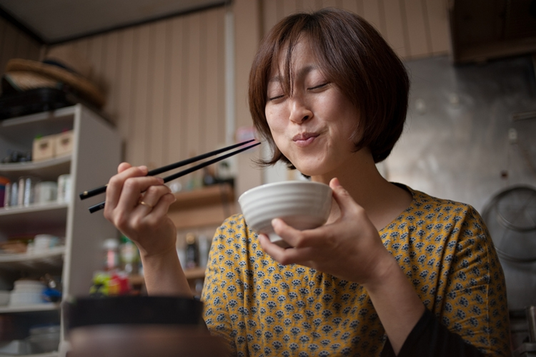
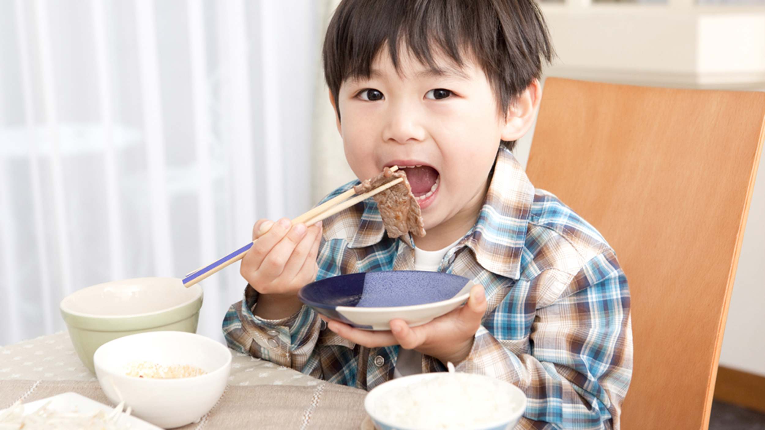
Once known in the west either in the form of "sukiyaki" or the more exotic "sushi," Japanese cuisine has in recent years become much more familiar and appreciated around the world. Many visitors to Japan will have already sampled the pleasures of raw fish or batter-fried shrimp. Eating in Japan is an experience to be enjoyed and remembered fondly for the rest of your life.

Slide 3
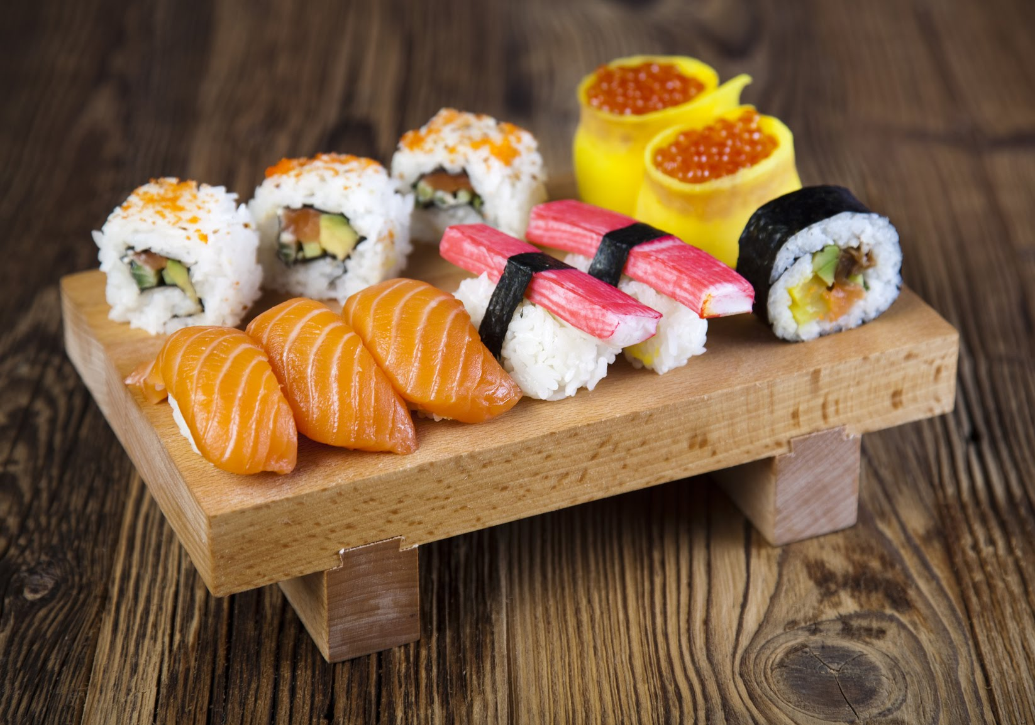
Sushi
One of the most famous food in the world. Sushi is a small piece of raw seafood placed on a ball of vinegared rice. The most common ingredients are tuna, squid and prawns. Cucumber, pickled radish and sweet egg omelet are also served.

Slide 4
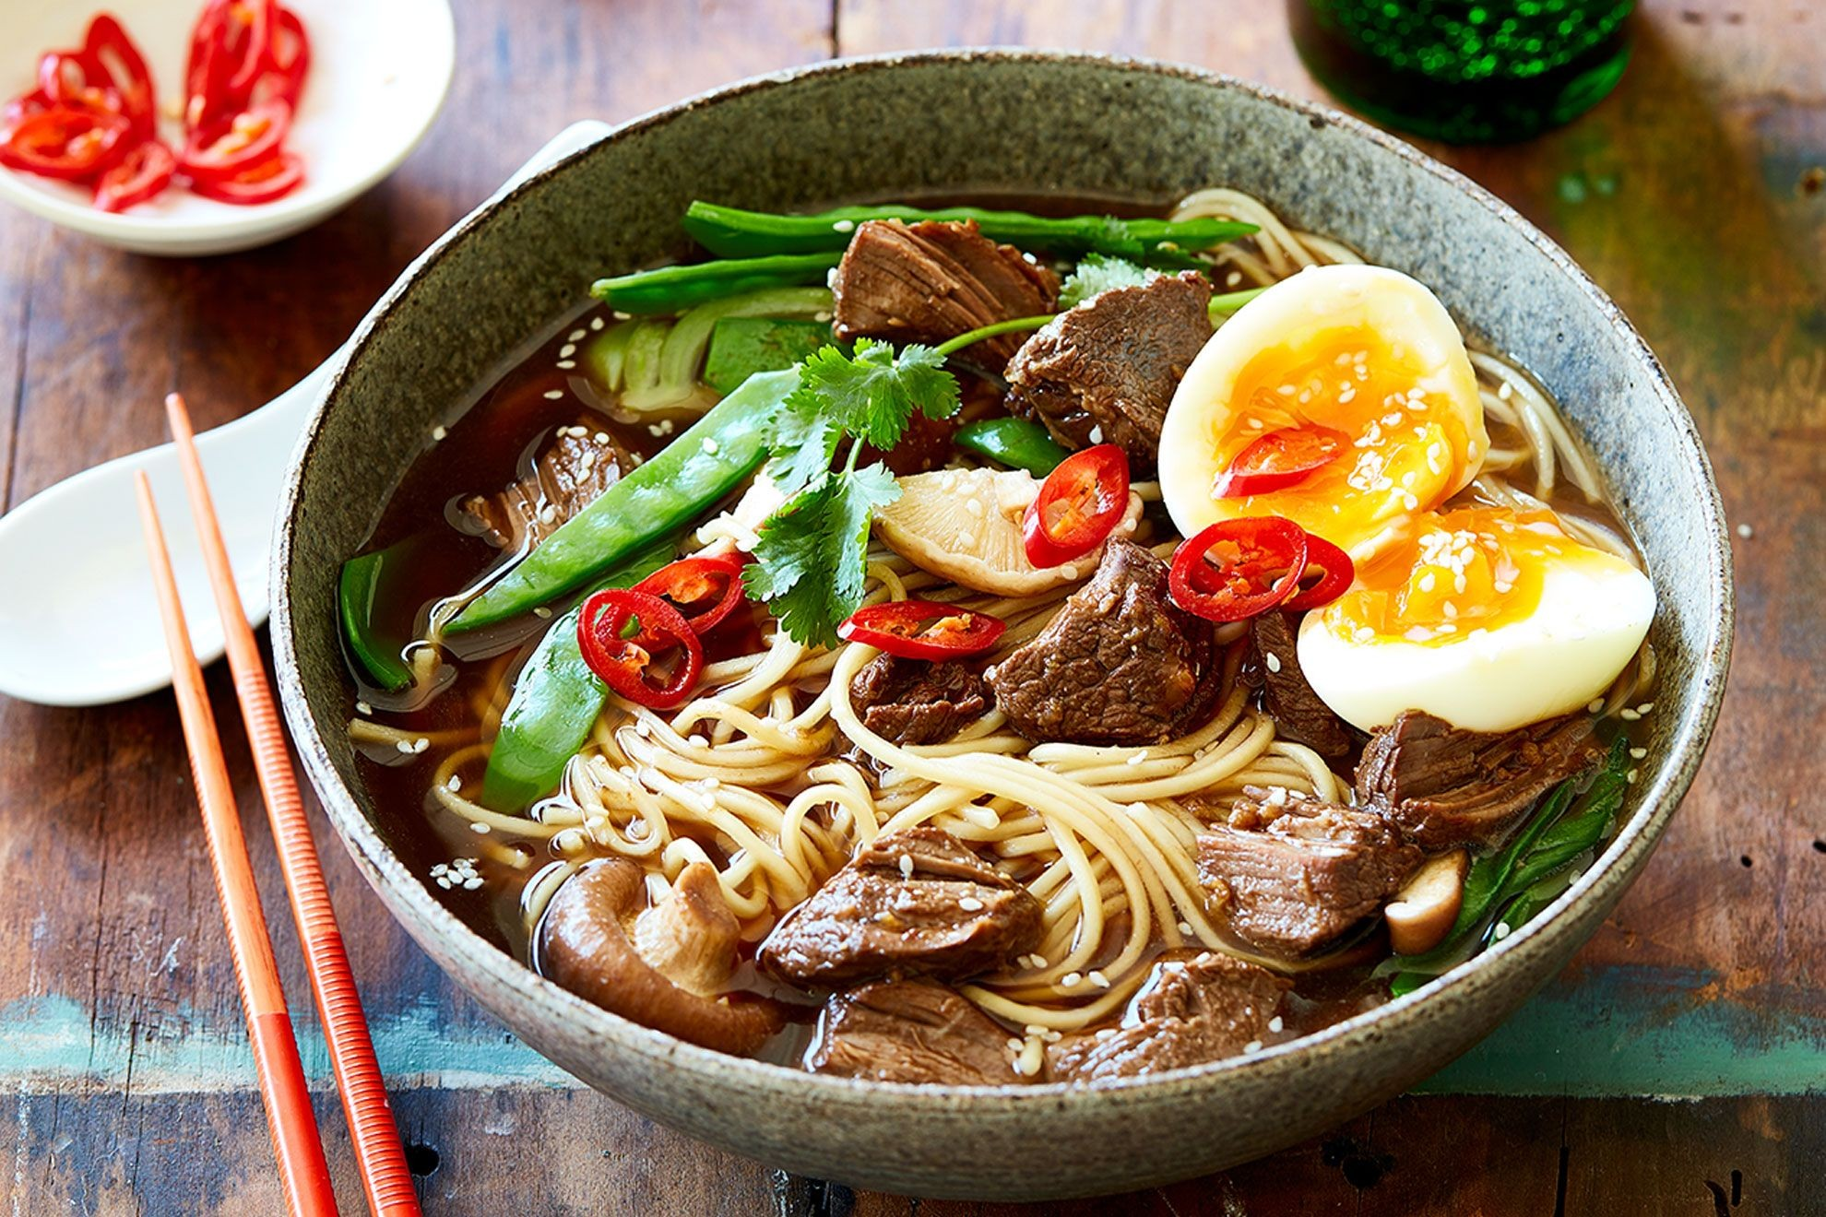
Ramen, egg noodles in a salty broth, is Japan’s favorite late night meal. It’s also the perfect example of an imported dish – in this case from China – that the Japanese have made completely and deliciously their own.
Ramen

Slide 5
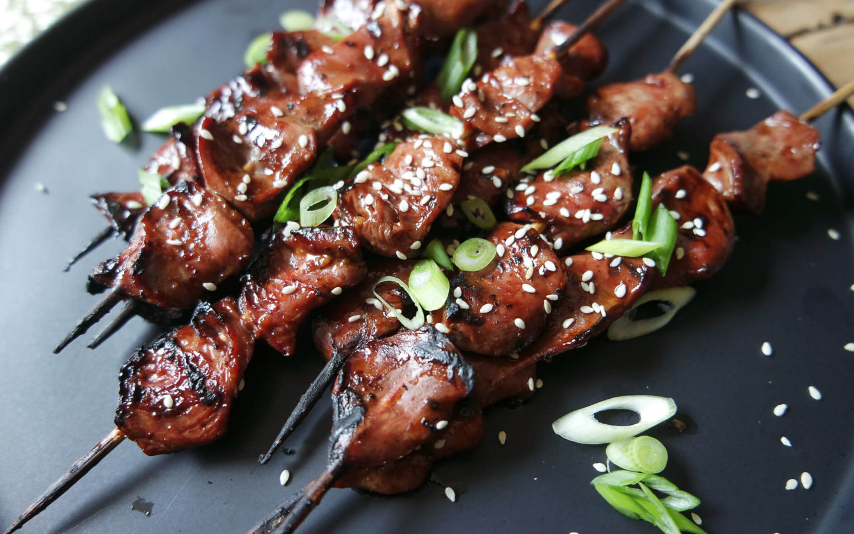
Yakitori is made up of small pieces of chicken meat, liver and vegetables skewered on a bamboo stick and grilled over hot coals.
Yakitori

Slide 6
Holiday food of Japan

Slide 7
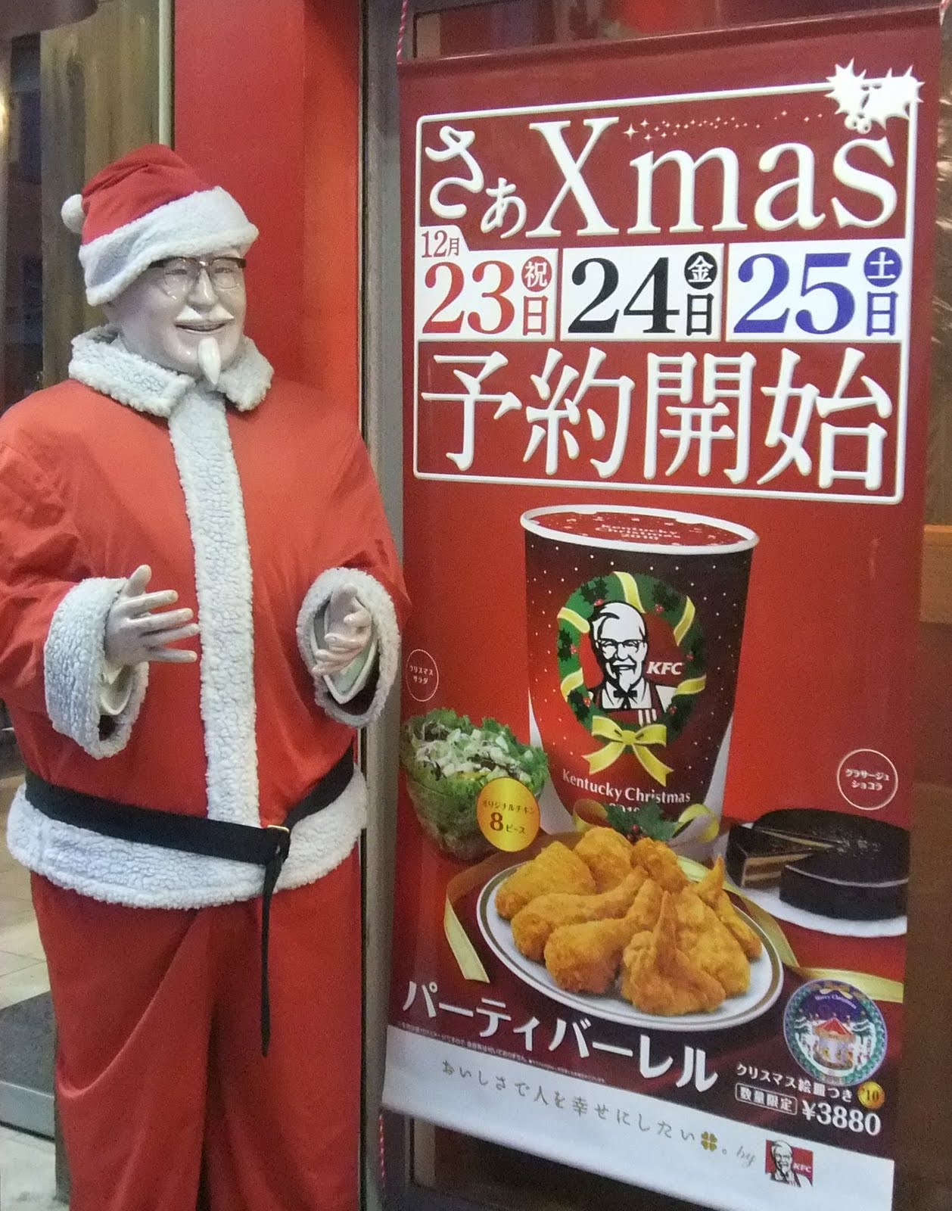
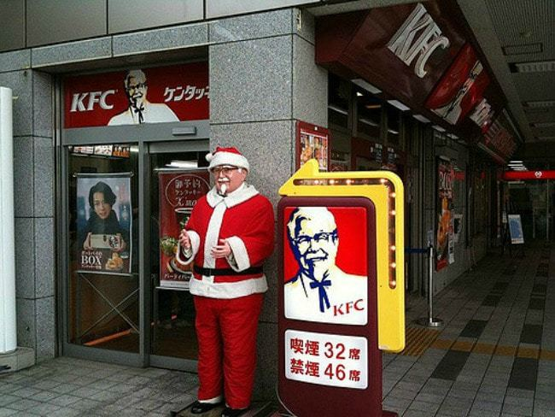
You’d expect all of the residents of Tokyo to celebrate the holidays with a dinner out. But in fact, on Christmas Eve you’ll find many families waiting in line for a bucket of Kentucky Fried Chicken. Capitalizing on the lack of turkey in Japan that caused visitors to seek out fried chicken as an alternative Christmas dinner, KFC launched a brilliant advertising campaign in the 1970s. As a result, “Sanders Claus” shows up each December and buckets of KFC are in such demand on Christmas Eve that Tokyo residents put in their orders as early as October. KFC’s in Tokyo even offer champagne and cake to go with their chicken.

Slide 8
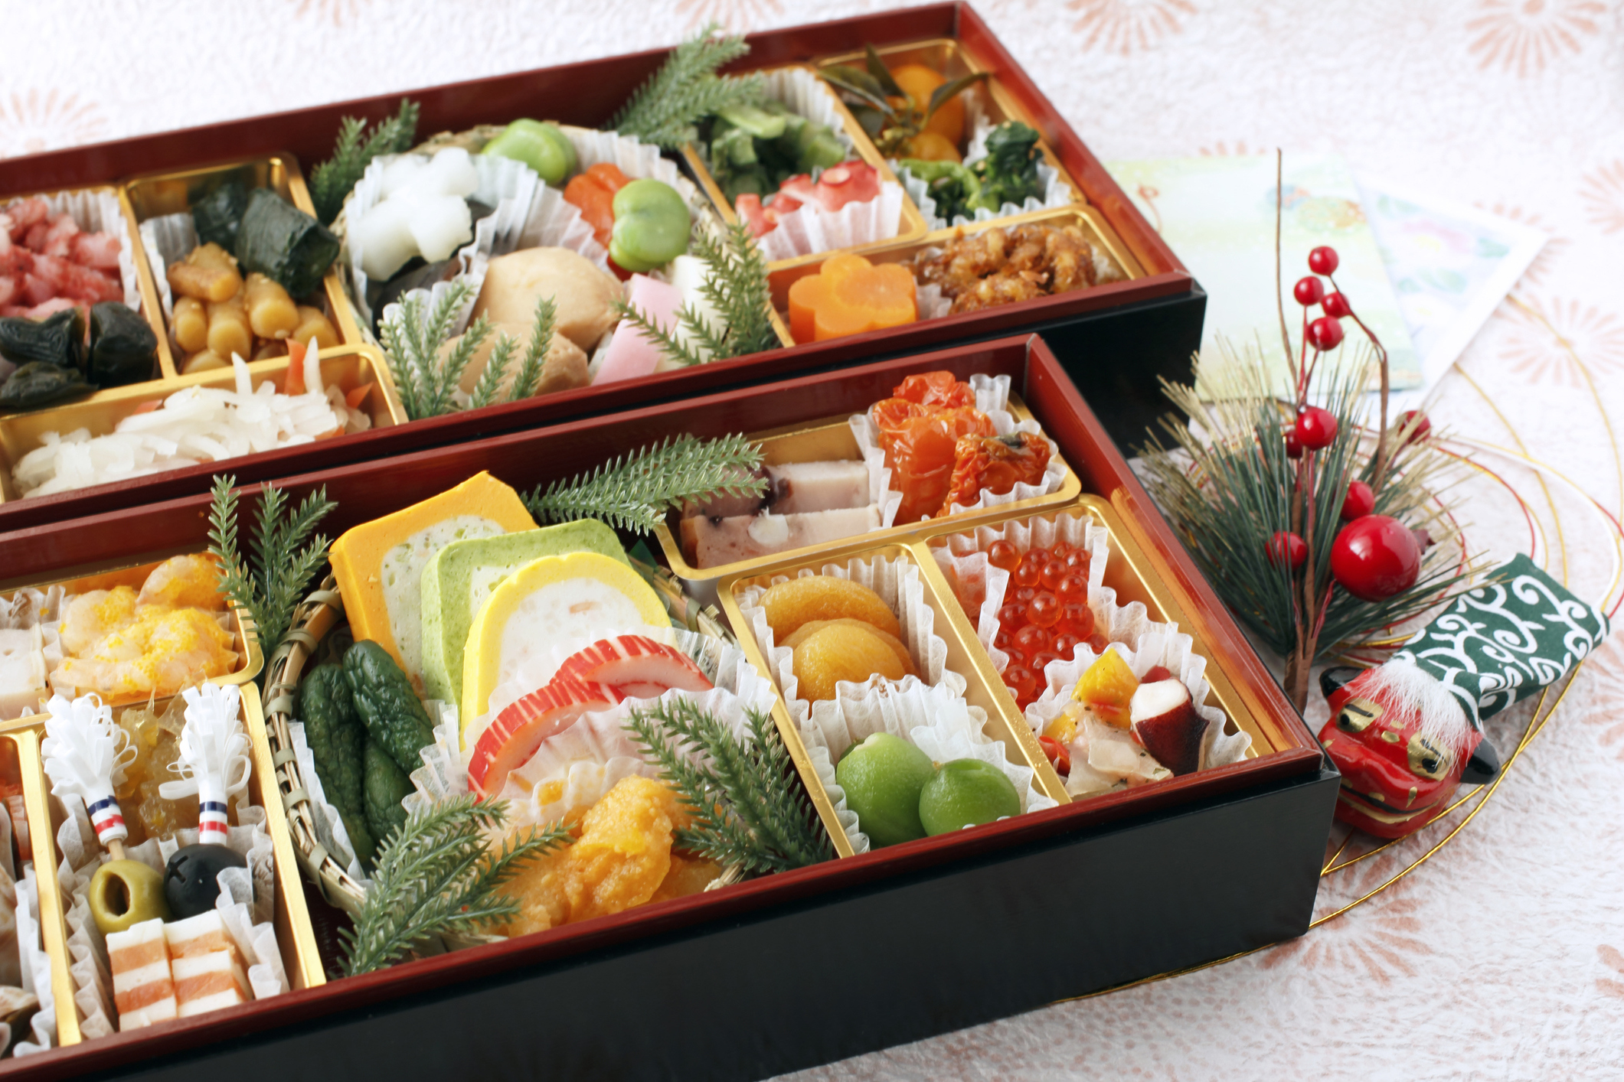
New Year’s is the most important holiday for the Japanese and comes with many traditions dating back a thousand years, including the eating of osechi ryori. According to tradition, nothing is to be cooked on New Year’s Day so osechi ryori is prepared in advance.The colors and flavors are rich in symbolism and are believed to bring a new year filled with health, prosperity, bountiful harvests and even children to those who partake.
Osechi Ryori

Slide 9
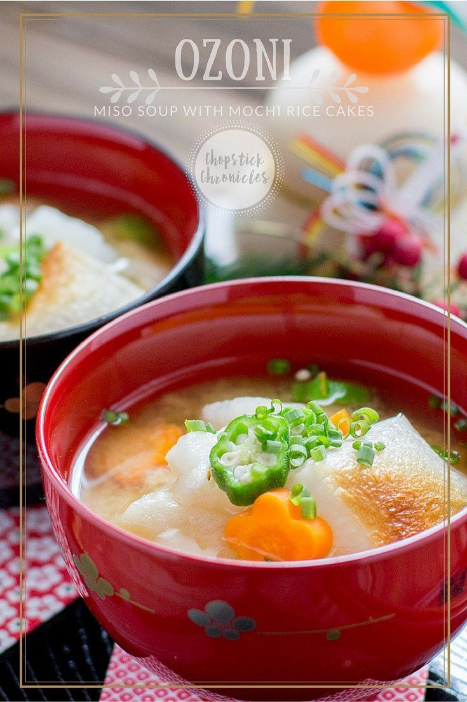
Ozoni Soup
Another traditional specialty is Ozoni, a soup containing mochi—boiled sticky rice that is mashed and formed into a white dumpling. Whether you’re visiting Tokyo for the holidays or throughout the year, you can rest assured you will eat well.

Slide 10
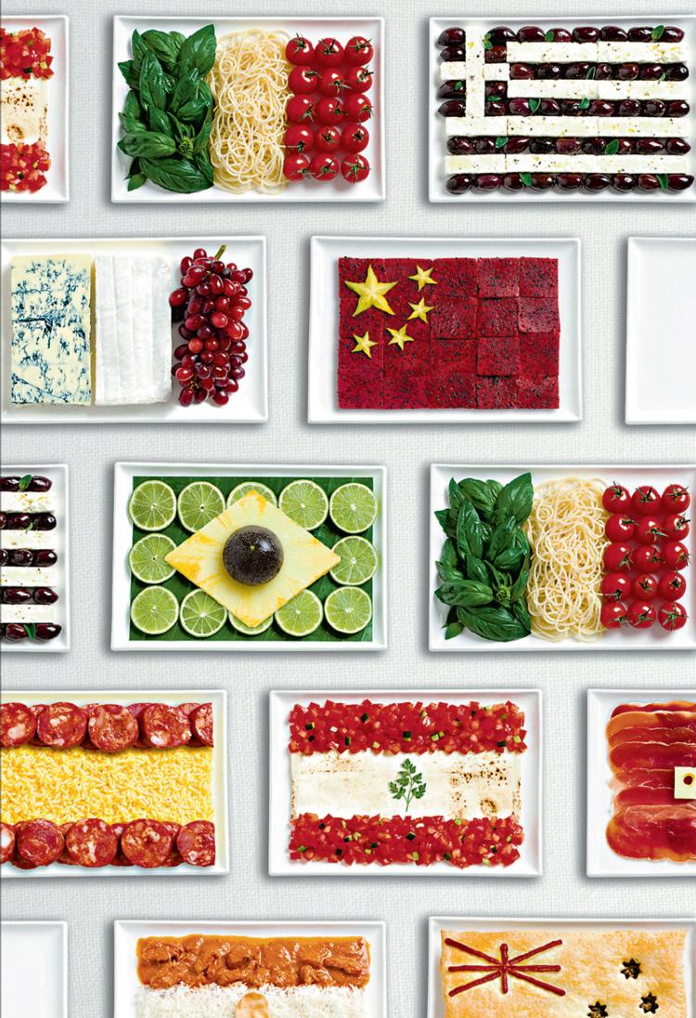
Nowhere is this more evident than in Tokyo where you’ll find every type of cuisine you could ever want—and an improved version of your favorites. The city of Tokyo has the most Michelin starred restaurants in the world: more than Paris and New York combined. It’s all here: French, Italian, the best steak houses in the world and more. In fact, more than a few people have told me the best Italian dinner they’ ve ever eaten was in Tokyo.

Slide 11
Thanks for watching

