Slide 1
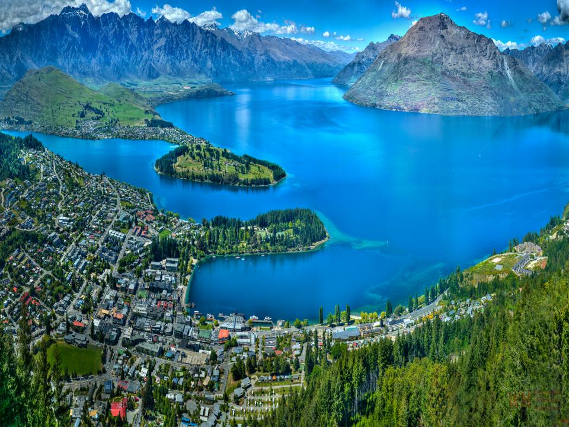
“New Zealand”
completed by Oksana Lepuha

Slide 2
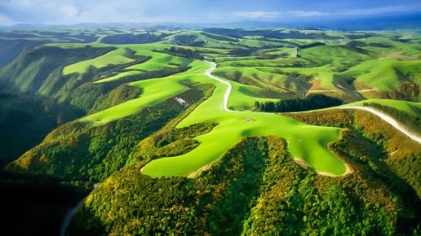
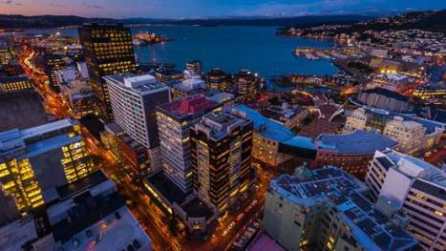
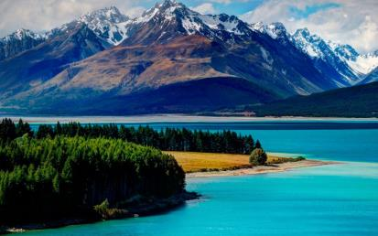
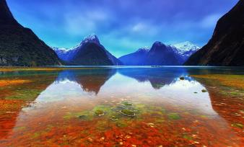
New Zealand is an island country in the Southwest Pacific Ocean. It lies about 1600 km southeast of Australia and about 10 500 km southwest of California. New Zealand belongs to a large island group called Polynesia. The country is located on two main islands — the North Island and the South Island — and several dozen smaller islands. The majority of the smaller islands are hundreds of kilometers from the main ones.

Slide 3
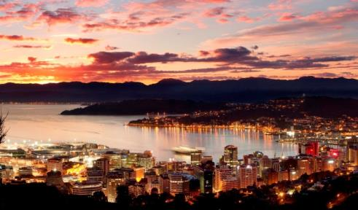
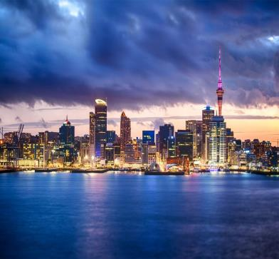
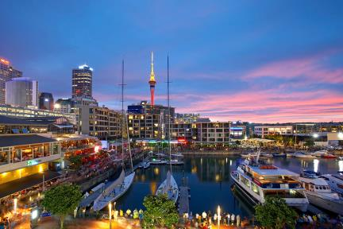
Wellington is the capital of New Zealand and Auckland is the largest city. English is the official language of New Zealand and is spoken throughout the country. Many native people speak their own language» Maori, in addition to English.

Slide 4
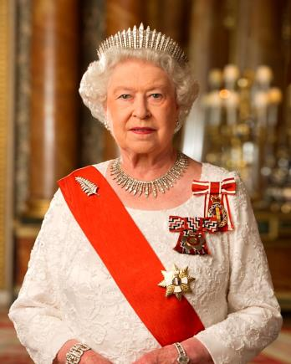
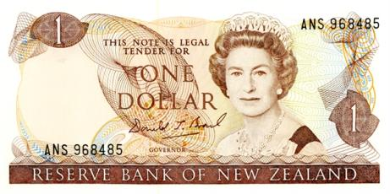
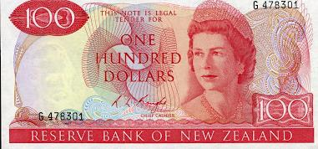
The country once belonged to the British empire. Today it is an independent member of the Commonwealth of Nations, an association of Britain and a number of its former colonies.
New Zealand is famous for being a constitutional monarchy. The British Monarch, Queen Elizabeth II of the United Kingdom, is the monarch of New Zealand. She appoints a governor general to represent her, but the governor general has little power. The legislation, prime minister, and Cabinet run the national government.

Slide 5
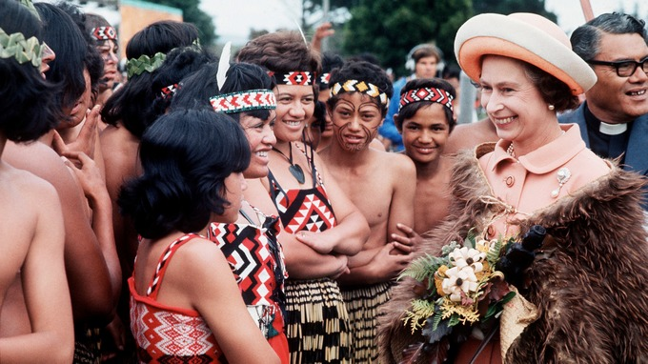
Britain gave New Zealand a constitution in 1852, when it was a British colony. But through the years the New Zealand legislature has changed almost all its provisions. Today, the nation has no written constitution.
The first people who settled in New Zealand were a brown-skinned people called Maoris. They came from Polynesian islands located northeast of New Zealand.

Slide 6
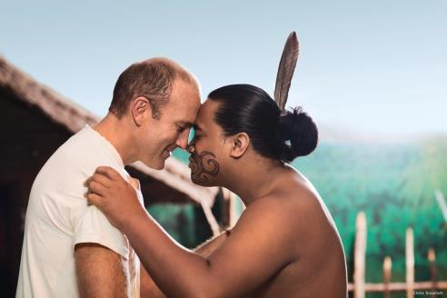
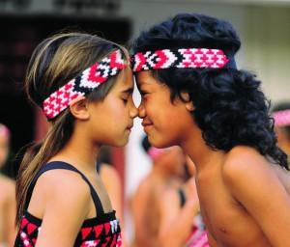
The country was discovered by Europeans in 1642, but they did not start to settle in the islands until the late 1700's. Today, most New Zealanders are descendants of the early European settlers. Maoris make up about 12 % of the country's population.

Slide 7
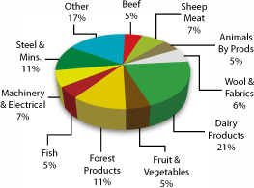
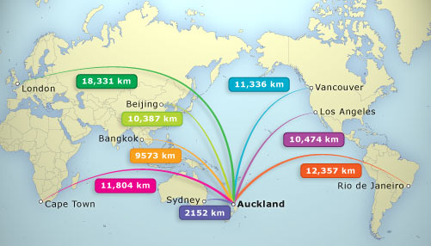
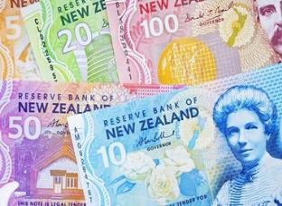
New Zealand has one of the highest standard of living in the world. For many years, the economy of the country depended largely on agriculture. Today agriculture, manufacturing, and service industries are all important to the economy. New Zealand's economy depends on trade with many countries — Australia, Britain, Japan and the United States.

Slide 8
2015

Slide 9
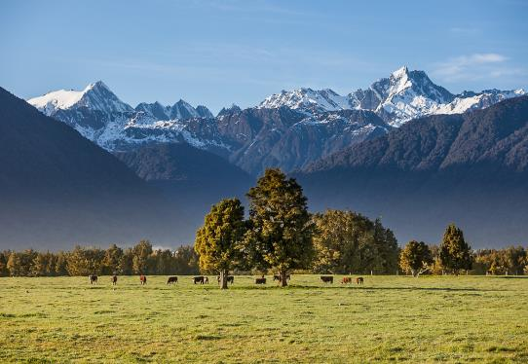
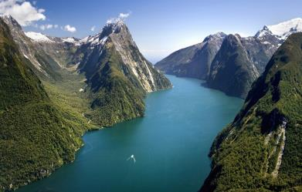
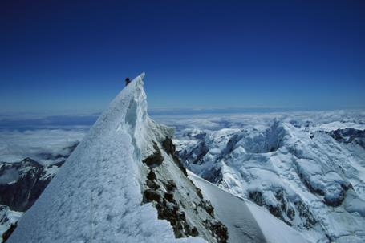
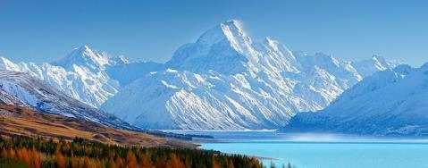
South Island is larger than North Island and has the highest mountains. There you can find the snow-capped Southern Alps, rising 3.764 metres to the tip of Mount Cook (named after Captain Cook, of course, because he visited the islands before sailing on westwards and discovering the eastern coast of Australia).

Slide 10
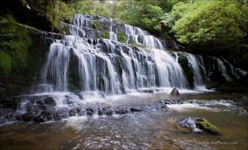
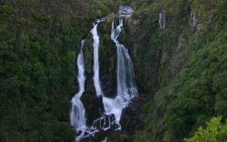
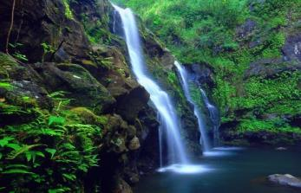
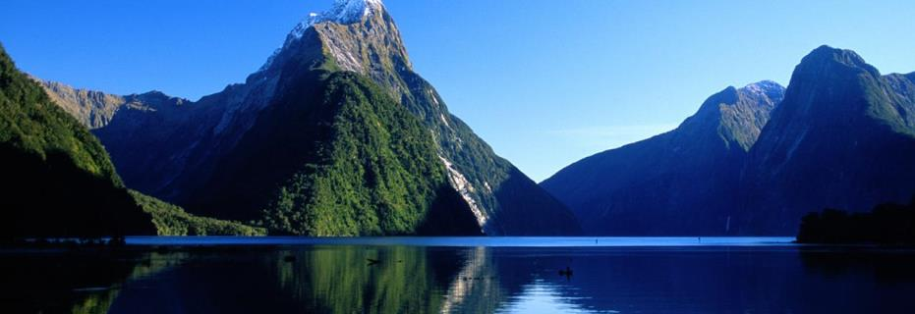
South Island is very beautiful with its Alps and lakes, its glaciers and fiords. Have you ever heard of Milford Sound? That is one of the most picturesque of the fiords, with cliffs rising straight up out of the water, the whole scene reflected in the water. Down there, too, are the Sunderland Falls, where water drops six hundred metres, making these falls one of the highest waterfalls in the whole world.

Slide 11
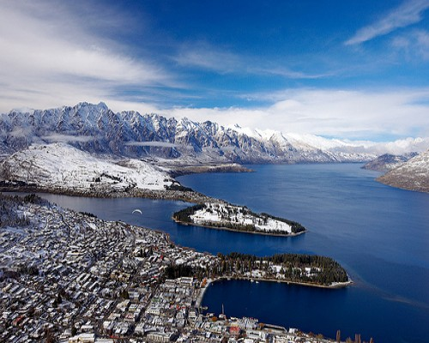
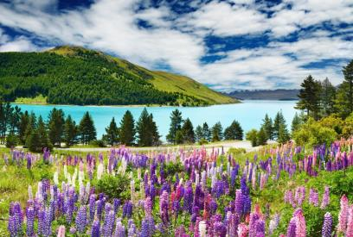
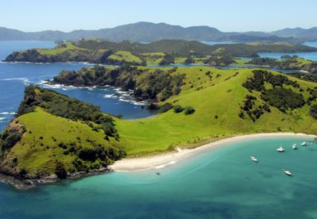
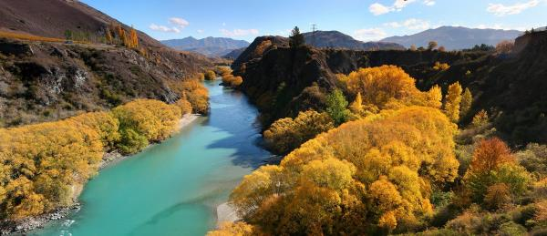
The climate is pleasant at all seasons, without much difference between winter and summer. New Zealand does not have the terrible heat of Australian summers; the oceans temper its climate and the mountains bring down quite a lot of rain.

Slide 12
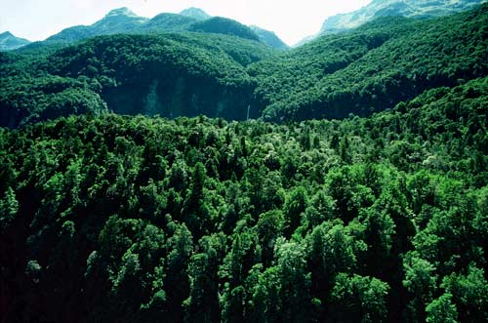
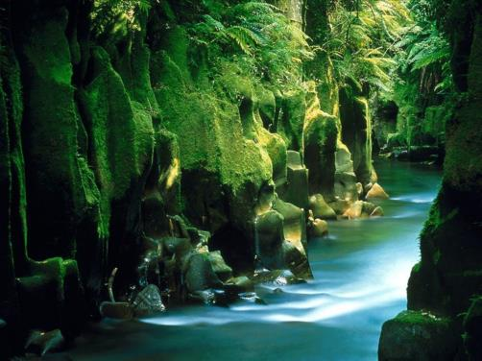
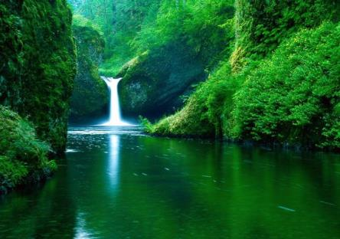
Forests of exotic pines near the centre of New Zealand's North Island, cover an area of more than 160000 hectares. This is the largest single continuous area of planted forest in the world. New Zealand has more than four hundred thousand hectares of planted forests.

Slide 13
“Thanks for attention”
completed by Oksana Lepuha

