Slide 1
Punishments and fines in Ukraine

Slide 2
Punishments
Punishment(penalties) - a measure of state compulsion upon conviction.
It applies to the person found guilty by a court of a crime and is deprivation or restriction of his rights and freedoms.
In the case of penalties pursued three objectives: -
restore social justice; -
correction of a prisoner; -
prevention of new crimes.

Slide 3
Punishments
The criteria for the classification of sentences may be:
a) their legal significance;

Slide 4
Punishments
b) connection with isolation from society;

Slide 5
Punishments
c) the presence or absence of restrictions of material nature;

Slide 6
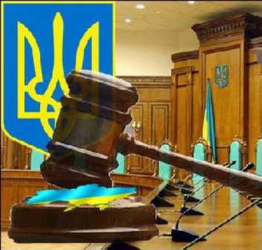
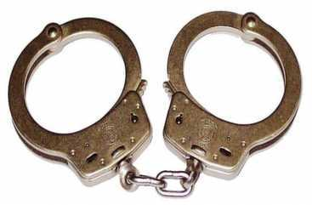
Punishments
d) subject to which the sentence;

Slide 7
Punishments can be different, and regard different fields of low:
In Criminal Low
Administrative Low

Slide 8
Punishments can be different, and regard different fields of low:
Civil Law
Business Law

Slide 9
One of variety of punishments is fine
Fine - a monetary penalty imposed by the court in cases and within the limits of the Criminal Code. He ranks first in the list of punishments and can be used as a main and additional punishment.

Slide 10
Fine
Fines applies to minors only in cases where they have an independent income, own funds or property which may be recovered (Art. 99 of the Criminal Code).

Slide 11
Fine
A fine set not in absolute numbers and in a certain amount of income tax exemption, which was officially established by legislation of Ukraine at the time of delivery of the verdict.

Slide 12
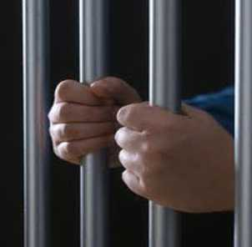
Conclusion
Consequently, fines and penalties in Ukraine are regulated by law. Penalties, their measure the amount of fines contained in the Code of Ukraine, depending on which area of law was made Offences and penalties should be applied.

Slide 13
Thanks for attention

