Slide 2
Capital punishment or the death penalty is a legal process whereby a person is put to death by the state as a punishment for a crime.
Death penalty was established under the rule of King Hammurabi of Babylon in the eighteenth century B.C.
It was very popular in the reigns of fourteenth and seventh century where capital punishment was the only punishment awarded to all kind of crimes.
The list of commonly referred names for the “Death Penalty”:
- Capital Punishment
- Death Sentence
- Execution
- Judicial Murder

Slide 3
Forms of Capital Punishment
Beheading (Saudi Arabia)
Lethal injection (USA, China, the Philippines, Singapore, Thailand)
Gas Chamber (USA)
Electrocution (USA)
Guillotine (France, Germany, Italy, Switzerland)
Hanging (USA, Egypt, Japan, South Korea, North Korea, Afghanistan, Pakistan, Iran)
Firing squad (USA, Belarus, Russia, China)
Stoning (Saudi Arabia, Pakistan, Sudan, Nigeria)

Slide 4
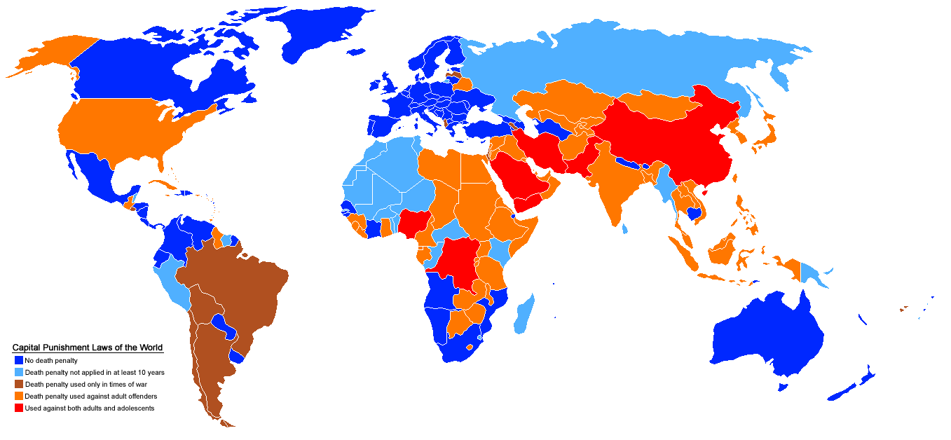
139 Countries around the world have abolished the death penalty.

Slide 5
The main aims of capital punishment
Deterrence
Reparation
Retribution
Protection
Vindication

Slide 6
Arguments For Capital Punishment
The death penalty is the only deterrent some people understand.
Some criminals might prefer execution to a life in prison.
Society must protect innocent people.
Justice must be seen to be done.
“Life” prisoners are often released early and may reoffend.

Slide 7
Arguments Against the Use of Capital Punishment.
People may be wrongly accused and executed.
The death penalty does not appear to work, the USA has a higher rate of violent crime than the UK.
The cost of keeping someone on death row is far higher than the cost of keeping them as a life prisoner.
Some criminals might be seen as martyrs.
A civilised state should defend life not kill.
Minority groups are far more likely to be given the death sentence in the USA.

Slide 8
What do Religious Teachings Say About Capital Punishment?
Take not a life, which Allah hath made sacred, except by way of justice and law.
Islam
No matter how evilly someone behaves they always have the possibility of correcting their behaviour.
Buddhism
Jesus taught compassion;
“If anyone of you is without sin, let him be the first to throw a stone…….”
Christianity

Slide 9
Should the death penalty be used to punish violent criminals ?

