Slide 1
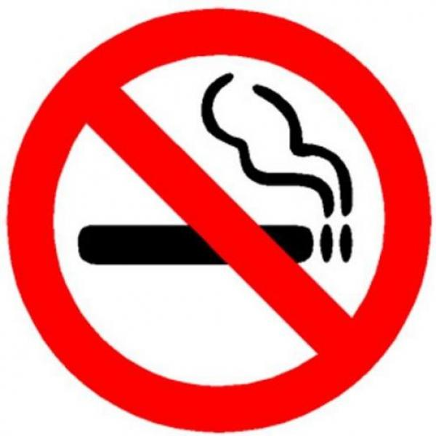
About the dangers of smoking

Slide 2
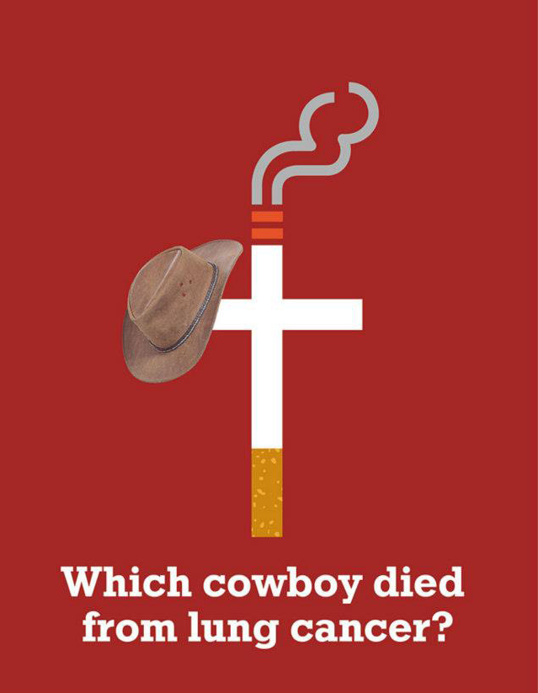
May 31 - day of
refusal of Smoking

Slide 3
"Smoker admits in his mouth the enemy who kidnaps the brain"(English proverb)
"Smoking grows dull, it is incompatible with creative work, "Goethe.
"Tobacco ... inevitably reduces the energy of the“ Honoree de Balzac.

Slide 4
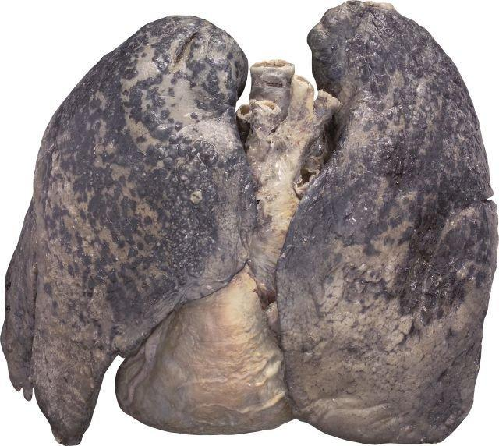
Smoking is one of the global threats to the health and well-being of the population. Annually from Smoking related diseases kill more than 5 million people. Every eight seconds in the world dies prematurely smoker. While you read it died one smoker...

Slide 5
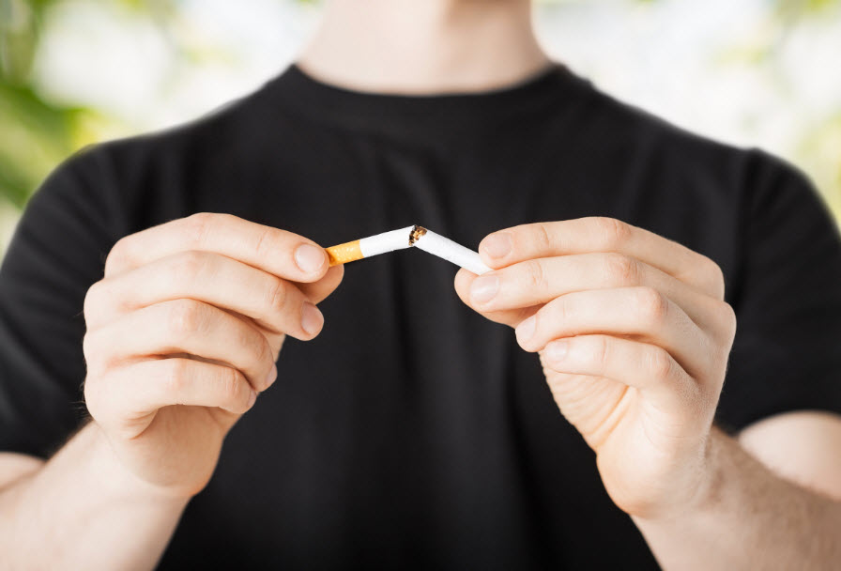
Nowadays every second person is Smoking. Much has been written about
Smoking: "Smoking kills", "Smoking contributes to cancer," "Smoking kills your
brain cells“ you can give a thousand examples, but it is unnecessary. People,
knowing that Smoking is injurious to health, still people smoke two or three
packs a day. But every surena cigarette reduces human life by 15 minutes.
Now imagine that the person had smoked 10 cigarettes i.e. his life was reduced
to 7 days. And it goes on from day to day, from year to year.

Slide 6
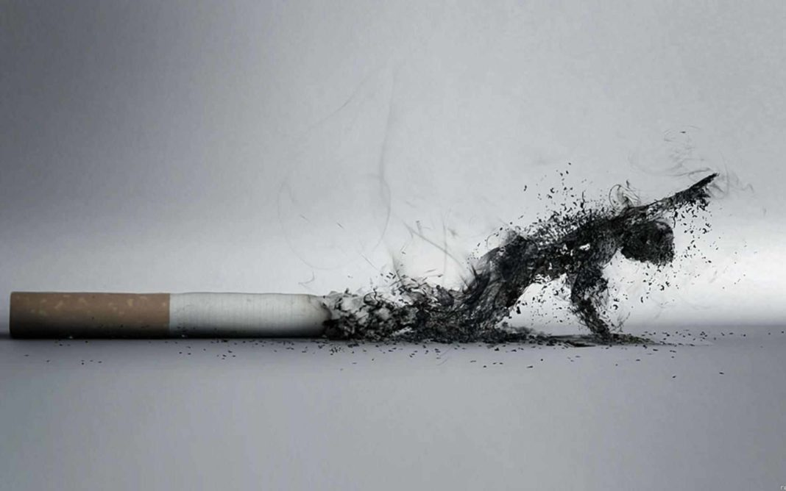
Smokers cause themselves great physical harm. How much money annually they are allowed on the wind, in the truest sense of the word, which would be enough to purchase useful things! And another thing: bad breath, yellow teeth, rough voice—all these are inevitable consequences of the dangers of Smoking does not make a person attractive.

Slide 7
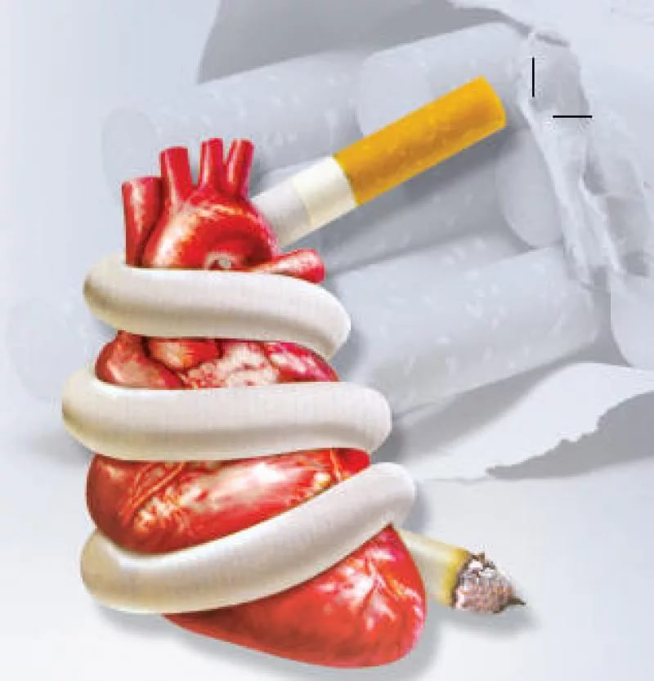
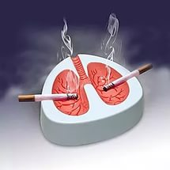
Numerous medical studies have shown that the main dangers of Smoking is expressed in the fact that Smoking leads to disruption of the rhythm of heart contractions, slows down, then paralyze the cells of the Central nervous system. The most significant dangers of Smoking is that it contributes to the development of such life-threatening diseases as myocardial infarction and lung cancer.

Slide 8
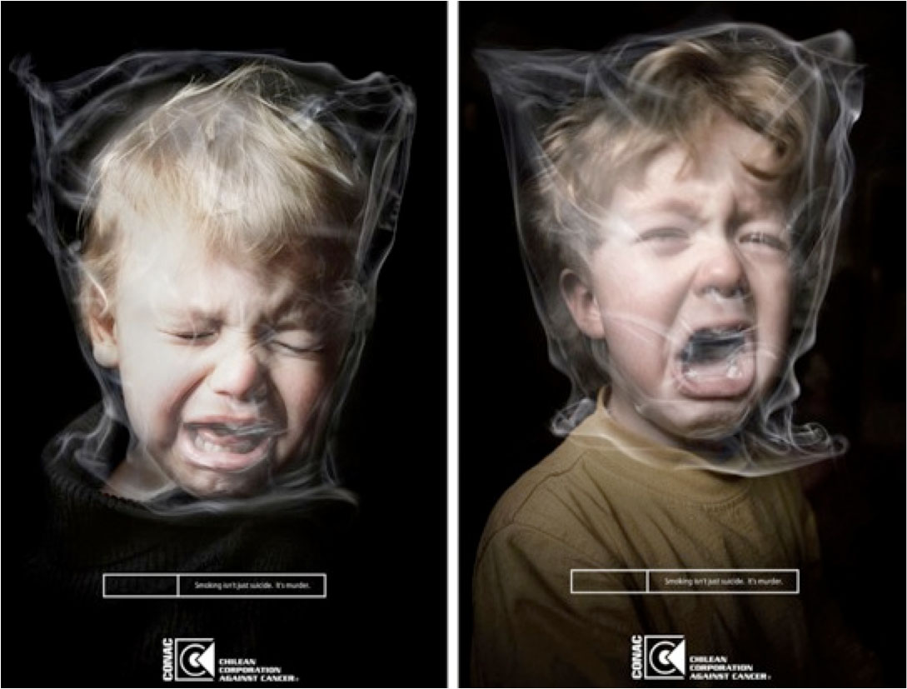
Effect on pregnancy
The harmful effects of tobacco on the fetus due to the fact that nicotine reduces placental blood flow and reduces the oxygen supply to the tissues of the growing organism. Smoking women miscarriages and still-born children found in 2-3 times more often than non-smokers.
The influence of nicotine on the fetus is easy to see that if we trace the fetal heart rate after maternal Smoking. The future of the child immediately comes increased heart rate. Of course, that a similar reaction may be the case that Smoking in the presence of a pregnant woman.
The ability of nicotine to cross the placenta and pass from the mother's bloodstream into the fetal blood gives the right to claim that Smoking of the mother before the birth of their child are poisoning him with nicotine.

Slide 9
in the movies
reality
The face of a smoker
The term "smoker's face" first appears in a scientific journal in 1985. The fact that 48 % of smokers and 8% of those who smoked in the past, the skin has a pale gray color and more pronounced wrinkles, but such changes are not seen in non-smokers — smokers elastic (a protein responsible for elasticity and tissue repair) becomes more dense and fragmented.

Slide 10
Stages of body recovery after quitting Smoking
20 minutes slight decrease in blood pressure
8 hours - blood is cleared of poisonous carbon monoxide, this eliminates bad breath, typical for smokers
24 hours reduces the risk of heart attack
48 hours worsen the taste and smell begins to fade physical dependence, psychological remains
3 months - blood circulation improves, increased by 30% lung capacity, improves sleep
9 months increases immunity to infections, cough disappears and the characteristic breath of a smoker, increases efficiency
1 year - 50% reduced risk of cardiovascular diseases in comparison with smokers
5 years
decreases in 2 times the risk of developing cancer of the oral cavity and esophagus, the risk of myocardial infarction and death from diseases of the coronary vessels is returned to the level characteristic of never Smoking
10 years
the risk of developing oral cancer is reduced in 2 times

Slide 11
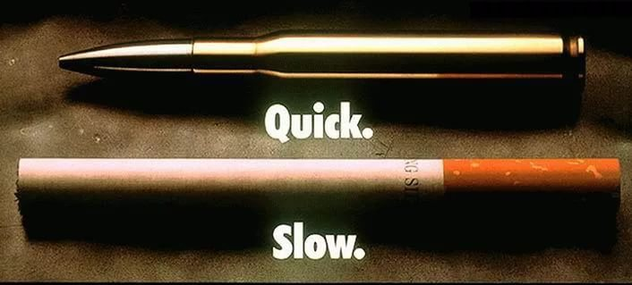
Did you know that...?
In addition to tar and nicotine under the influence of high temperature of the tobacco is about 30 hazardous substances: hydrogen sulfide, ammonia, nitrogen, carbon monoxide and various volatile oils, among which are especially hazardous benzidine — wide carcinogen. Tobacco smoke contains a significant amount of polonium-200, which emits alpha particles. When Smoking one pack of cigarettes a person receives a dose of 36 rad, what is 7 times higher than the dose established by the agreement on radiation protection. Tobacco smoke harmful effect on the heart, blood vessels, etc.

Slide 12
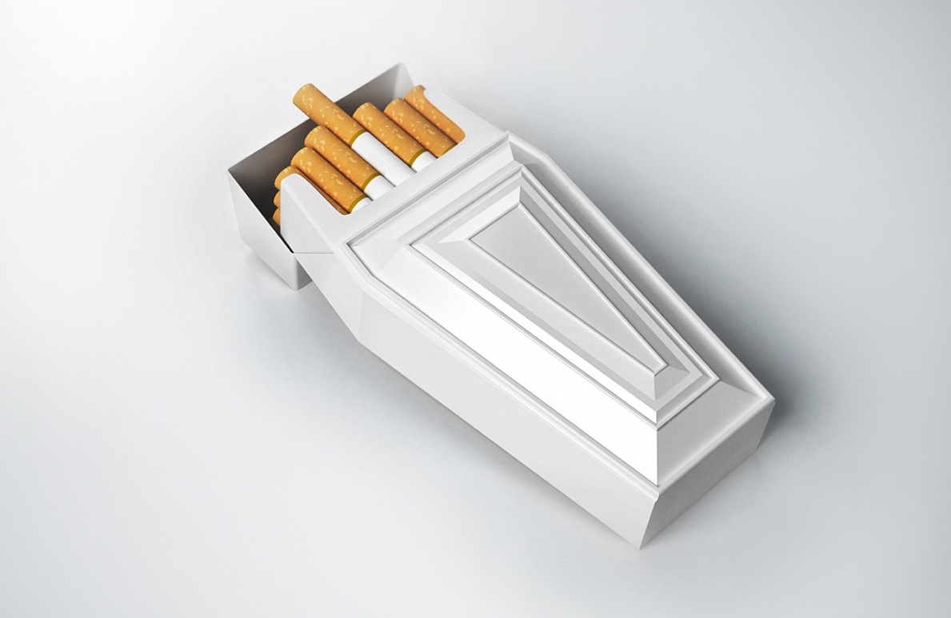
Smokers endanger not only themselves but also the people around them. In medicine there was even the term "passive Smoking". This can be explained as: the average concentration of nicotine in the body non-smokers after one and a half hour stay in smoke-filled and unventilated room increases by 8 times.

Slide 13
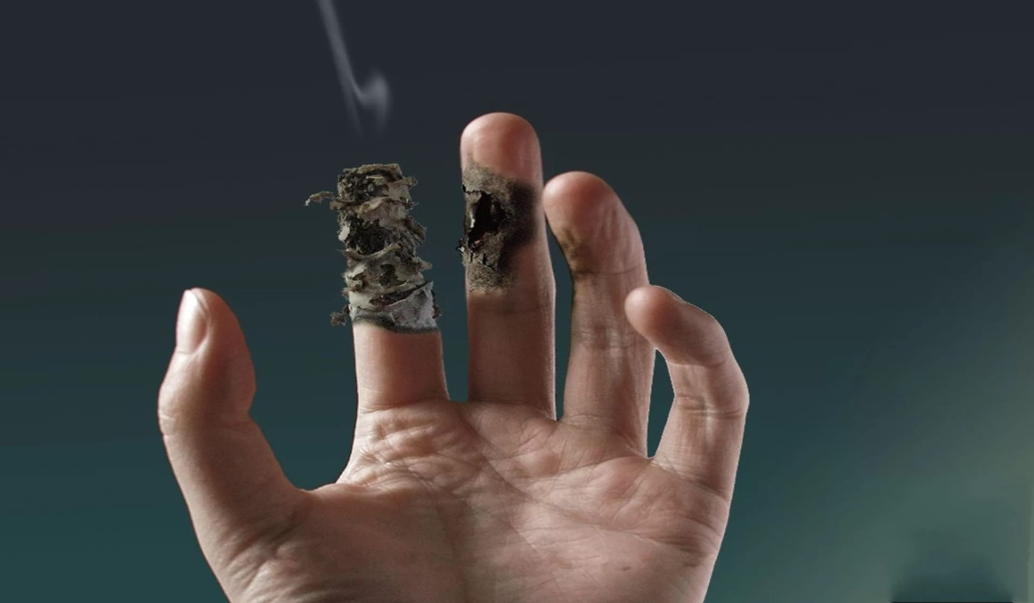
Smoking teenagers is alarming for several reasons. First, those who began daily Smoking in adolescence, usually smoke all my life. Second, Smoking increases the risk of developing chronic diseases (heart disease, cancer, emphysema).Third, although chronic diseases associated with Smoking, usually appear only in adulthood, young smokers are more likely to suffer from cough, dysfunction of the respiratory tract, the formation of sputum, shortness of breath and other respiratory symptoms.

Slide 14
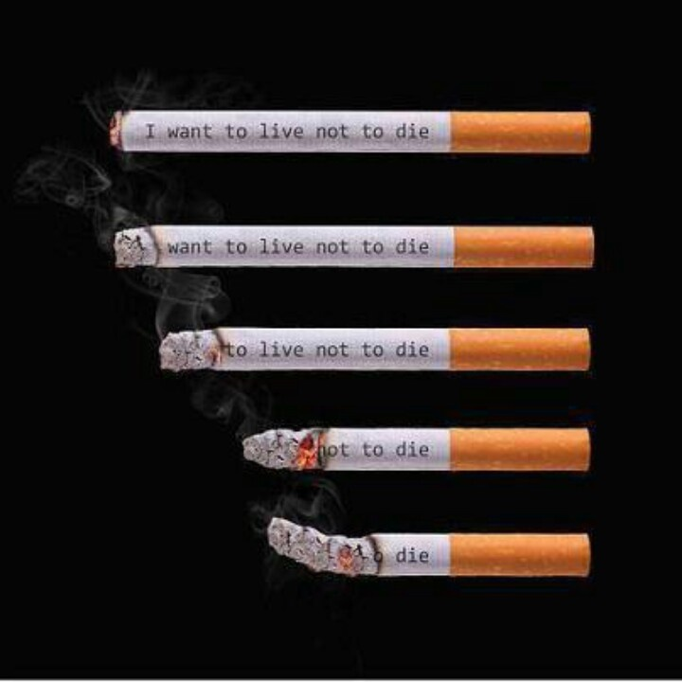
After having browsed the web, saw that many users are concerned about "how to quit Smoking fast?" and asked this question a huge number of users (80,000 per month). Agree, a huge number of people trying to find the answer to the question "how to quit Smoking?".
Nicotine dependence – that is, it does not to quit Smoking.
To quit Smoking is a very difficult process, but people survive it and become independent, healthy people.

