Slide 1
Types of conditional sentences
in the English language
Renkus V. V.
412 - AN

Slide 2
CONDITIONAL SENTENCES
Zero
conditional
Half-open
condition
Mixed
conditional
Open
condition
Closed
condition

Slide 3
Zero conditional sentences
This type of conditional sentences is used to describe scientific facts, truisms, events and phenomena that are always true.
Present Simple
if
Present Simple
Water boils if you heat it to 100 degrees Celsius.
A red light comes up if you press the main button.

Slide 4
Open conditional sentences
Such sentences
are used to express the real and possible situations in the future; it is likely that the condition will be satisfied.
If we get the money for this job, we will buy a new car.
We will stay at home if it snows.

Slide 5
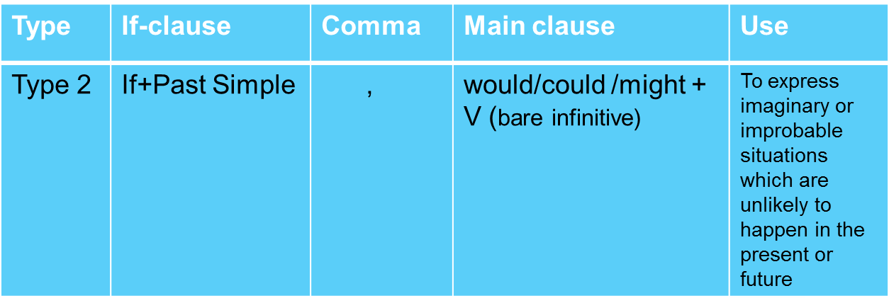
Half-open
condition
This type of conditional sentences describe the actual situation relating to the present or future tense; hypothetical condition that can be performed only in theory.
If my car broke down, I would take a bus.
I would take a bus if my car broke down.

Slide 6
Also half-open conditional sentences are recommended to use in case of a polite request.
I would be grateful
if you helped me.
He would be so pleased
if you came to the birthday party.

Slide 7
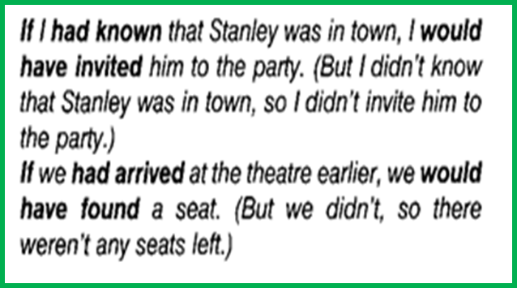
Closed
condition
Closed conditional sentences are describe the impossible condition, as an action or event has taken place in the past.
They are usually used to refer to a missed opportunity.

Slide 8
Mixed
conditional
This type of conditional sentences implies using of different parts of the previous types.
There are several combinations: the result of this action highlights the condition of the last time, the result of an action in the past emphasized the condition of the present time.
I would buy a house by the sea (now or in the future) if I had won the lottery last week.

Slide 9
Phrase If I were you, or If I were in your place is usually used to give advice.
If I were you I would accept the offer.
If he were in your place he would do it.

Slide 10
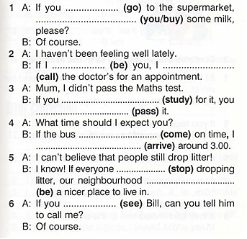
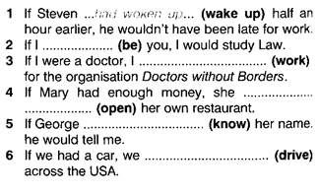
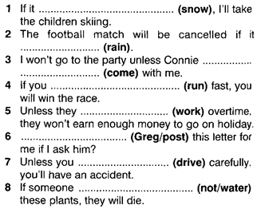
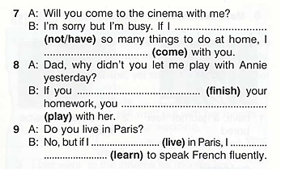
Task 1
Task2
Task3

