Slide 1
My favorite movie.

Slide 2
The film, which made ​​me a lasting impression, a great work of director James Cameron's " Titanic ." This film lasting more than three hours. The film released film company "Columbia Pikchers" together with "Twentieth Century Fox". For the Ukrainian and Russian audience he was dubbed by several broadcasters and channels.

Slide 3
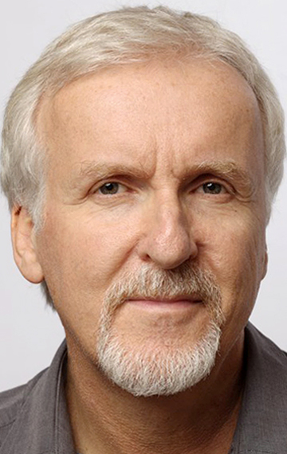
The film's director - a well- known Canadian James Cameron, popular for its bahatobyudzhetnymy kinohitamy . The " Titanic " refers to the terrible disaster. What happened April 12, 1912 in the Atlantic Ocean, where more than 1,500 people have died in the icy water after an incredibly huge and luxurious passenger liner "Titanic" sank .

Slide 4
Love
Against this background, blooming love of two young people, severely separated his position in society. This story is not typical, most forbidden love story of tragic circumstances. The climax of history - is both time when Rose (American aristocrat, engaged to a rich and promising fiance) and Jack (liberal poor artist who won his ticket to the 3 class card game) despite the differences between them realized that their love is real the only thing is to live. At the same time the ship struck an iceberg and began to sink.

Slide 5
The end of the film is quite logical. Rose, whose thoughts and soul completely changed after the death of Jack hid from her fiance and start a new life under the name of a man who will never be her husband, but she truly loved. Rose refused the false glitter of its aristocratic past.

Slide 6
It is difficult to imagine a film , which would be dominated by only one component - the game whether it cast. Naturally , the " Titanic " both are perfectly aligned and improve each other. Dialogues are not too long. They are just to make the right impression on the audience .

