Slide 1
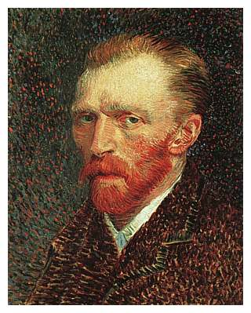
Vincent Van Gogh

Slide 2
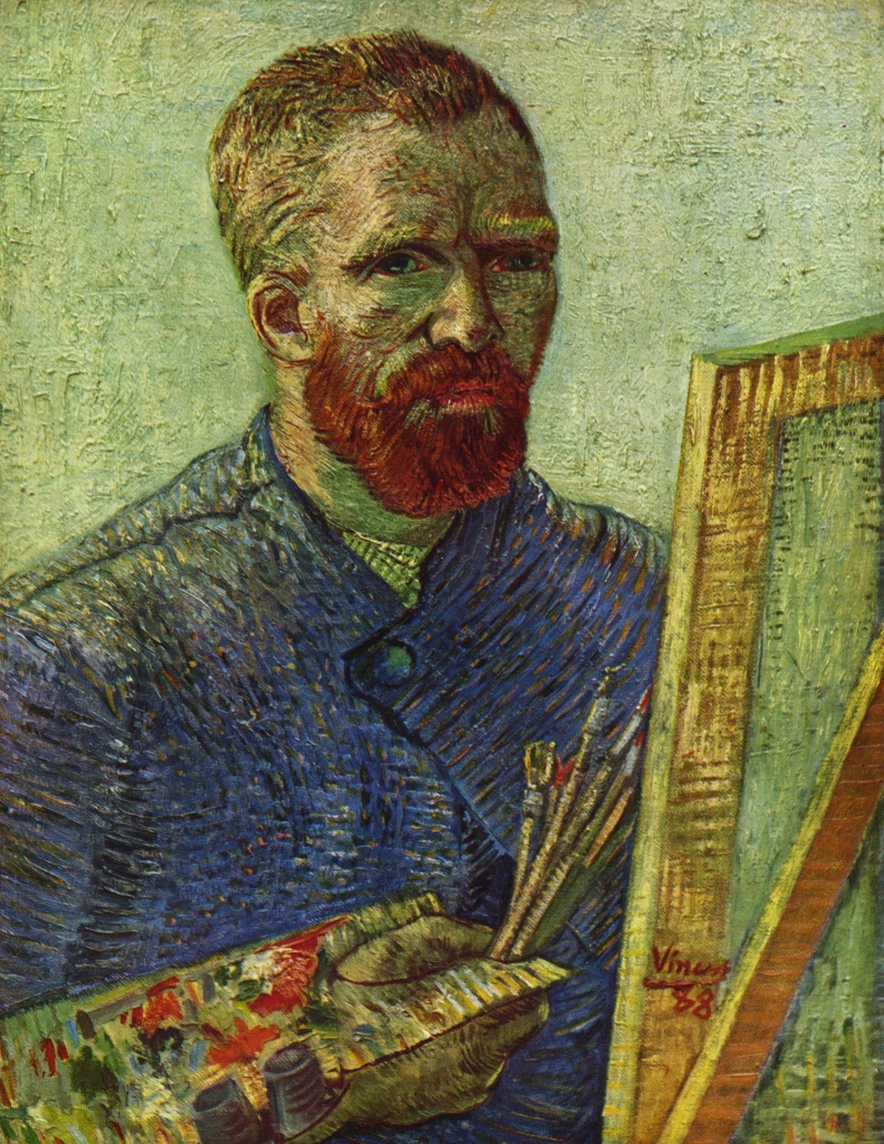
Vincent was born on 30 March 1853 in the Netherlands. He studied at the village school. A year later he began to study at home. In 1866 became the College of Tilburg, where the first lessons of painting. But in 1868 he returned home.

Slide 3
1869 began working in art-trading firm in the Hague. After four years he was transferred to the London branch of the same company. He began to understand painting.
In 1876 he decided to become a preacher. In England, Vincent worked as a teacher, assistant pastor. van Gogh made a few sketches on religious themes. Van Gogh abandons the facilities, and distributing property.

Slide 4
Van Gogh painted many paintings at the time, and the style of it changes to 1886. In 1888, after moving to Arles, van Gogh again changes the style, but retains the characteristic dynamics of the stroke. A great artist as a result of a mental illness was treated in hospital for the mentally ill, and on 29 July 1890 he killed himself.

Slide 5
Van Gogh painted Starry Night while in an Asylum at Saint-Remy in 1889. There is the night sky filled with swirling clouds, stars ablaze with their own luminescence, and a bright crescent moon. Although the features are exaggerated, this is a scene we can all relate to, and also one that most individuals feel comfortable and at ease with. This sky keeps the viewer's eyes moving about the painting, following the curves and creating a visual dot to dot with the stars. This movement keeps the onlooker involved in the painting while the other factors take hold.

Slide 6
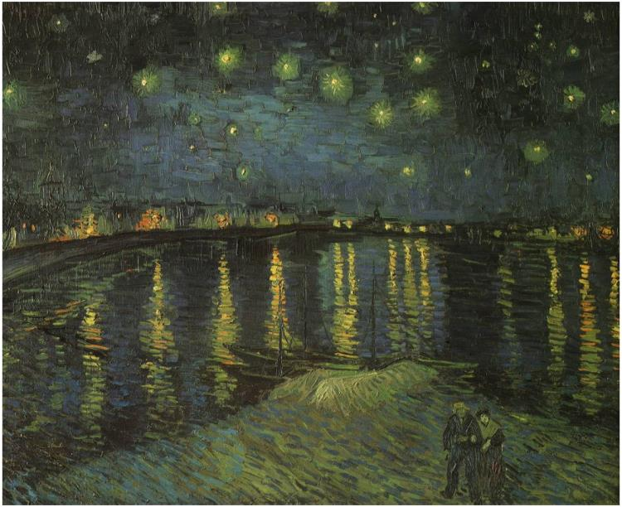
Starry Night Over the Rhone
As an artist, Vincent Van Gogh was prone to painting places and locations that had personal meaning and were familiar to him. Starry Night commemorates the view Van Gogh had from his window during his hospitalization in the mental asylum in Arles in 1889. Painted a little over a year before that, Starry Night Over the Rhone is the view Van Gogh had of the Rhone River from his rented apartment in Place Lamartine. Although Starry Night is more famous, Starry Night Over the Rhonecommemorates a happier time in Van Gogh's life and autobiography.

Slide 7
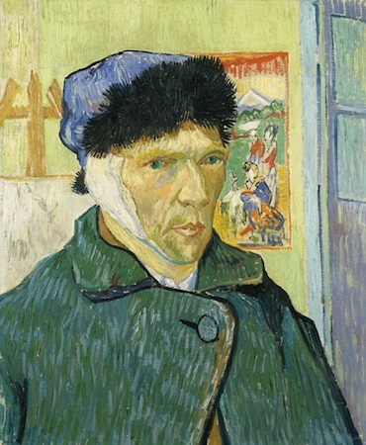
Self-Portrait with Bandaged Ear (1889)
After cutting off a portion of his right earlobe during a manic episode while in Arles, Van Gogh painted Self Portrait with a Bandaged Ear while recuperating and reflecting on his illness. He believed that the act of painting would help restore balance to his life, demonstrating the important role that artistic creation held for him.

Slide 8
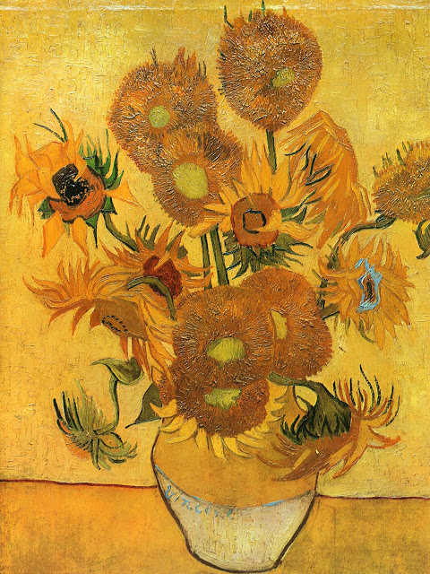
“Fourteen Sunflowers in a Vase, 1889” is one of many van Gogh paintings with similar names. It was painted in 1889 and is the one bought by the Yasuda Fire & Marine Insurance Company of Tokyo, Japan in 1995 for US$36.23 million. Few people are aware that of his 871 paintings, Vincent sold only one during his unusual lifetime —The Red Vineyard -- which he painted the year after this one and which was bought by a fellow artist who was the sister of a friend.

