Slide 1
Royal Ontario Museum
The museum of modern art

Slide 2
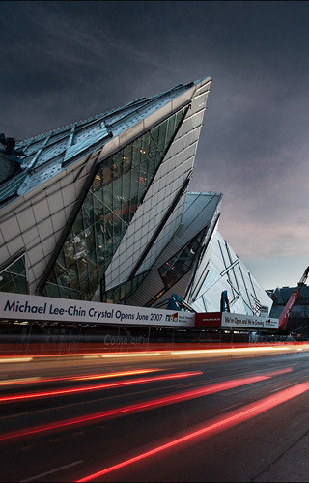
The Royal Ontario Museum is a museum of art, world culture and natural history in Toronto, Canada. It is one of the largest museums in North America, the largest in Canada, and attracts over one million visitors every year.

Slide 3
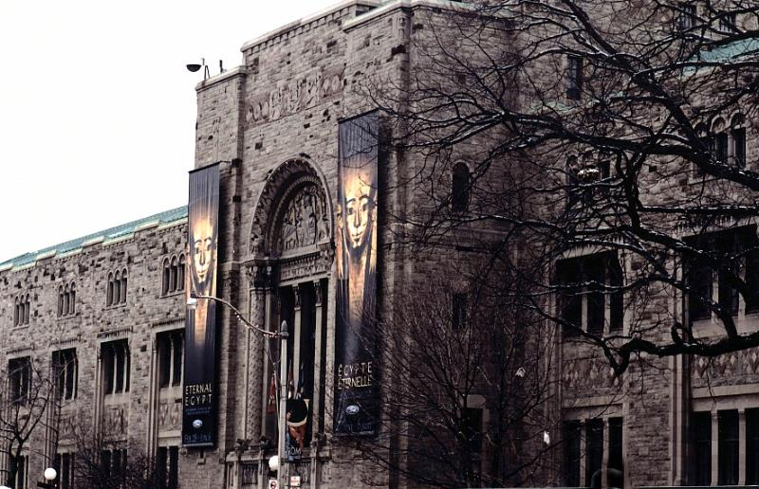
History
The Royal Ontario Museum was formally established on 16 April 1912. And nn 19 March 1914, at 3:00 pm, the Duke of Connaught, also the Governor General of Canada, officially opened the Royal Ontario Museum to the public.

Slide 4
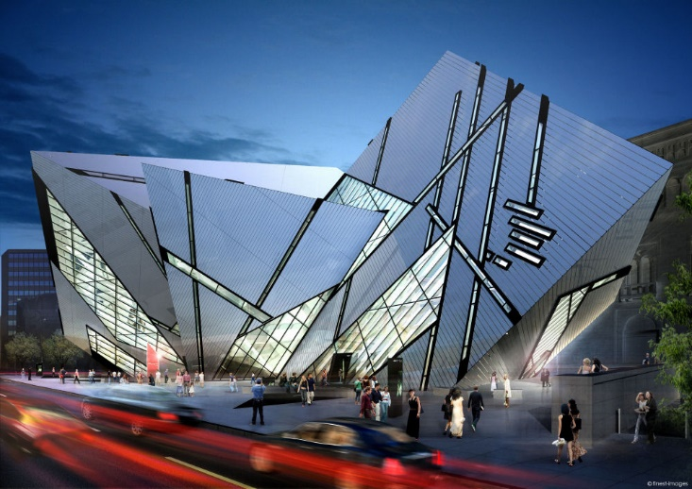
Interior of the Crystal
The new main entrance to the Royal Ontario Museum, Daniel Libeskind's The Crystal, first opened in 2007. The Deconstructivist crystalline form is clad in 25 percent glass and 75 percent aluminium, sitting on top of a steel frame.

Slide 5
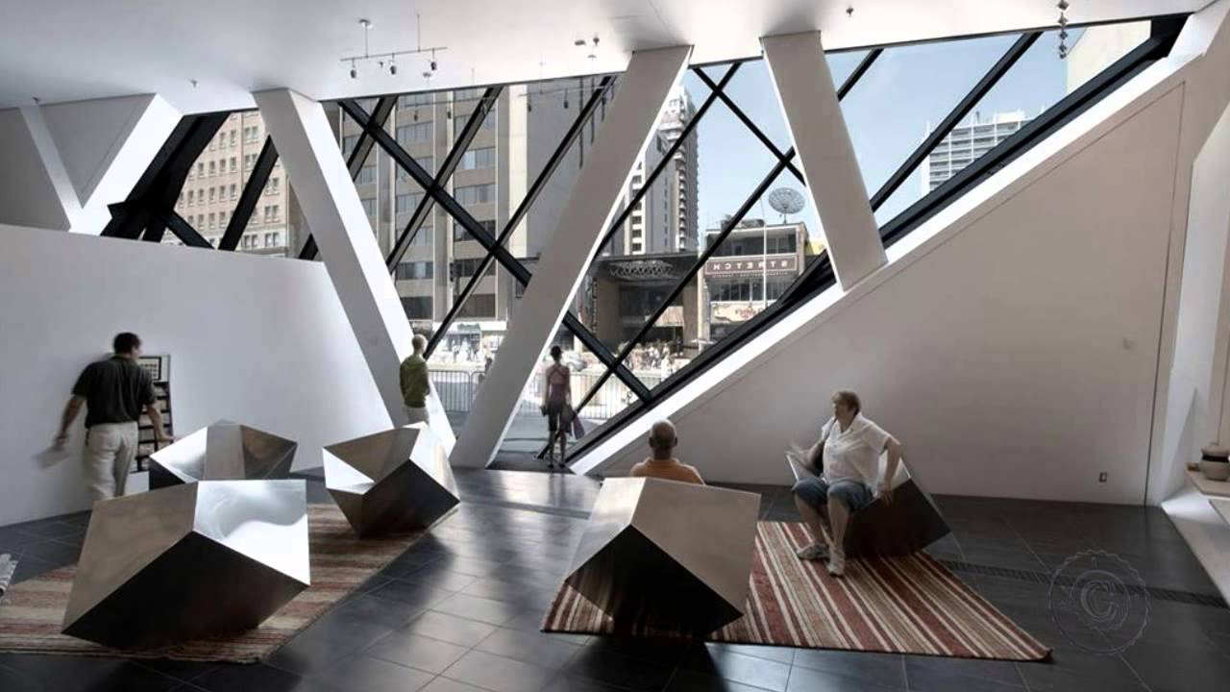
Galleries
Originally, there were five major galleries at the ROM, one each for the fields of archaeology, geology, mineralogy, paleontology, and zoology.
There are now two main categories of galleries present in the ROM: the Natural History Galleries and the World Culture Galleries.

Slide 6
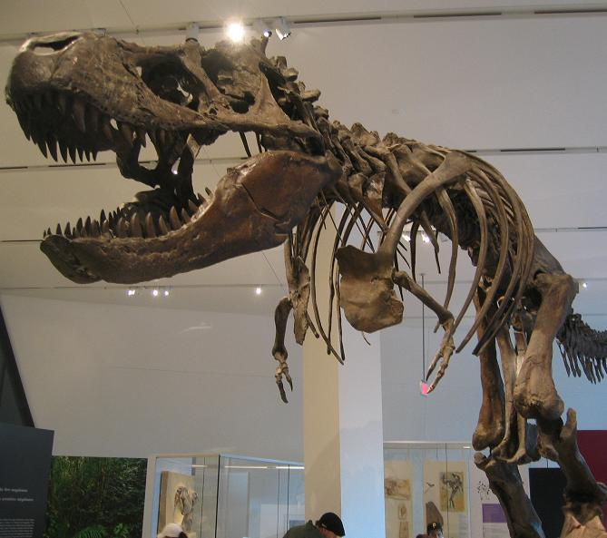
Natural History galleries
The exhibit in 2008, in the new Michael Lee-Chin Crystal gallery.
The Natural History galleries are all gathered on the second floor of the museum. The gallery contains collections and samples of various animals such as bats, birds, and dinosaur bones and skeletons.

Slide 7
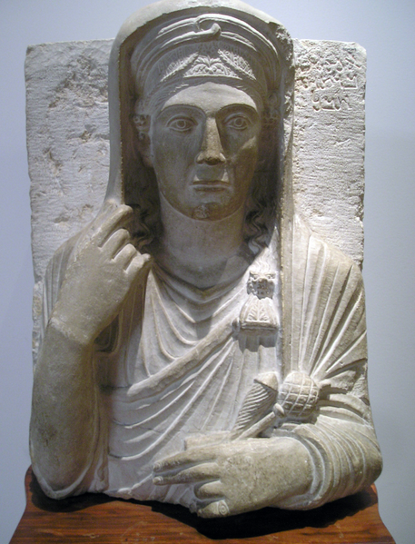
World Culture galleries
The World Culture galleries display a wide variety of objects from around the world. These range from Stone Age implements from China and Africa to 20th-century art and design.

Slide 8
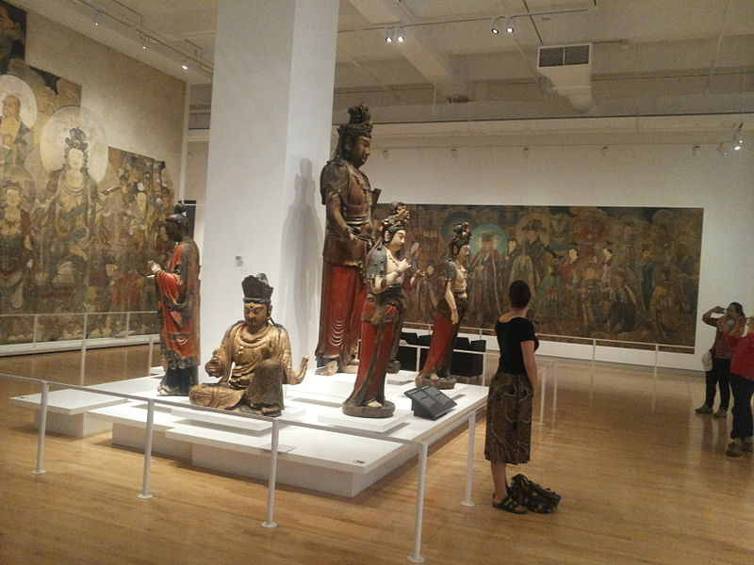
East Asian
The Chinese Galleries comprise four sections: the Bishop White Gallery of Chinese Temple Art, the Joey and Toby Tanenbaum Gallery of China, the Matthews Family Court of Chinese Sculpture, and the ROM Gallery of Chinese Architecture.

Slide 9
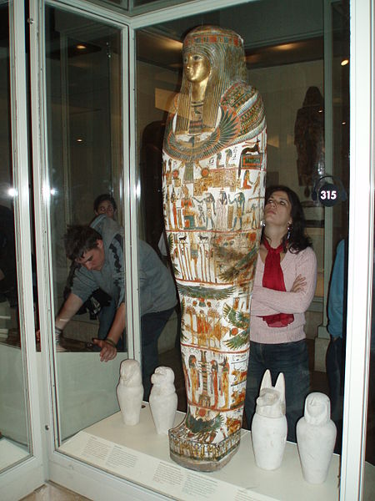
Ancient
Includes 8 galleries of the ancient world. Such as:
Eaton Gallery of Rome;
Joey and Toby Tanenbaum Gallery of Rome and the Near East
Joey and Toby Tanenbaum Gallery of Byzantium
Galleries of Africa: Nubia
And other…

Slide 10
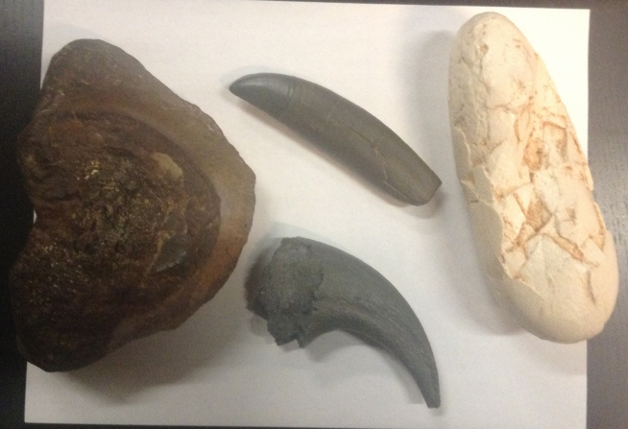
Hands-on galleries
The Discovery Gallery was designed to be a kids' learning zone. It houses three main areas: In the Earth, Around the World, and Close to Home.
The Patrick and Barbara Keenan Family Gallery of Hands-On Biodiversity introduces visitors to the complicated relationships which occur among all living things in a fun and interactive space.

Slide 11
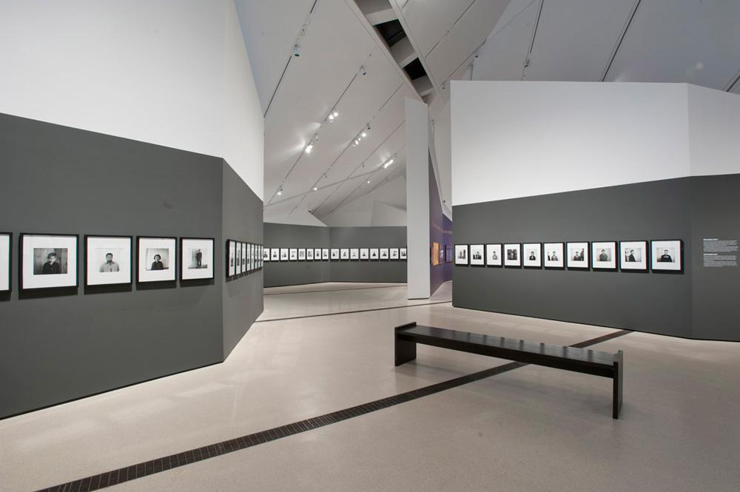
Institute for Contemporary Culture gallery
The Roloff Beny Gallery of the Institute for Contemporary Culture (ICC) hosts the Royal Ontario Museum's contemporary art exhibitions. This high-ceilinged multimedia gallery of approximately 6,000 sq ft (600 m2) serves as the ICC's main exhibition space and the ROM's window on contemporary society

Slide 12
THE END ☺

