Slide 1
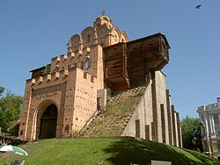
Golden Gate

Slide 2
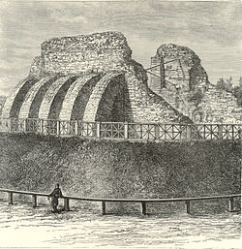
"Golden Gate" - the main gate of ancient Kyiv, a monument of defensive architecture of Kievan Rus , one of the oldest buildings dating from Eastern Europe, a symbol of Kyiv

Slide 3
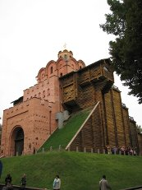
On the construction of the Golden Gate mentioned in chronicles in 1037 year

Slide 4
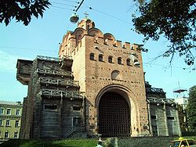
It is not known who had the look right. According to research the width of the main volume amounted to 10.5 m, height of 13.36 m, length 17.65 m.

Slide 5
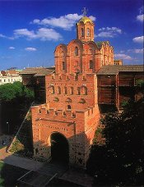
In mentioning the construction of the church over the Golden Gate passage in the Chronicle, it is mentioned in the "Sermon on Law and Grace" Metropolitan Hilarion:

Slide 6
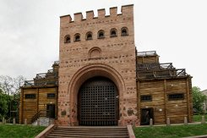
Museum Golden Gate
In 2006 the museum was closed, and the walls and play valuable cultural monuments of the capital mutilated numerous graffiti. Golden Gate were in disrepair. Since 2009, the museum was repaired and reopened to visitors.

Slide 7
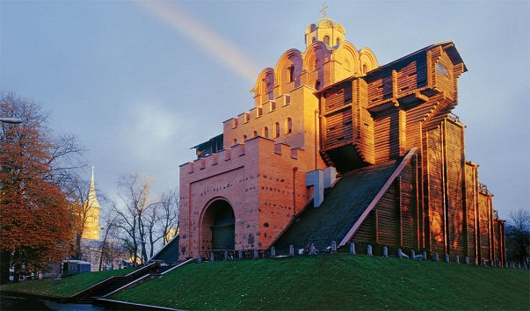
Historian Nicholas Zakrevskii called Golden Gate, "a precious remnant of ancient splendor and glory Kyiv"
«дорогоцінним залишком давньої величі й слави Києва».

Slide 8
The end

