Slide 1
Problems Between Parents and Kids

Slide 2
Overview
The teen years are fraught with conflicting feelings and thoughts as these almost-grown children head closer to adulthood. Parents are often left wondering what happened to their delightful kids who went from happy-go-lucky to moody, frustrated, conflict-ridden adolescents. KidsHealth from Nemours advises distinguishing the difference between emotion-driven adolescence and puberty, which is physiological.

Slide 4
Independence and Control
During the teen years, children naturally move toward establishing independence, according to The F.U.N. Place website, or Families United on the Net. Most teenagers are heavily influenced by people outside their family with music, what to wear and other fads that their parents may not approve of. Parents need to realize that this is normal and they are still important in their children lives, even when it appears that the teens are trying to push them away. The teenagers are trying to exert their independence as they head closer to adulthood.
As the teen gets older, she is likely to fight for control, which may create conflict with her parents. This can leave her parents feeling hurt and rejected, creating stress because there is a constant battle of wills. As the teenager asserts her independence over friends, clothes, music, curfew and other issues, taking a risk to overcome her fear of not gaining control and becoming an independent adult.

Slide 6
Experimenting
The teenage years are also the time when kids start experimenting with risky behaviors, such as drugs, alcohol, tobacco and sex, claims the KidsHealth website. Without a foundation of knowledge and understanding of expectations from the parents, the teenager is more likely to be confused when the parent expresses disapproval after the fact. Parents need to communicate and educate their children before they hit the teen years, and communication lines need to remain open, or the problems will escalate. The Psych Central website states that a high-quality relationship between parents and their teenage children appears to lead to teens postponing trying alcohol until a later age.

Slide 7
Expectations
Parents have expectations of their children with everything from grades in school and how they dress to college and career choices later on. Parental disappointment creates conflict and problems in the relationship between them and their teenagers. It often comes across as anger, giving teenagers the feeling of rejection from the people who were once the most important figures in their lives.

Slide 10
Inner Struggle
Teenagers struggle with role confusion and identity, claims groundbreaking developmental psychologist and psychoanalyst Erik Erickson, according to Theravive. Teens are constantly trying to filter confusion between society labels of who they should be versus who they really are as individuals. Teens need to feel as though they belong to a unit while remaining a unique individual. Theravive claims that this struggle is responsible for many teenagers being attracted to gangs.

Slide 11
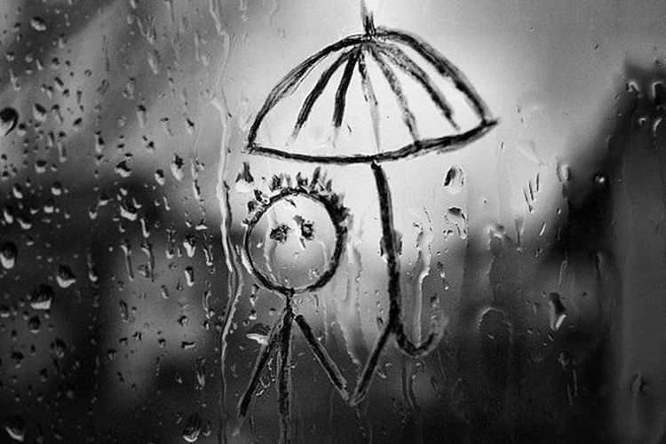

Slide 12
Family Conflict
When parents argue, teenagers may feel that they were somehow the cause, according to Teen Advisor. This can lead to alienation if the parents allow their words and actions to escalate out of control. Teens may feel that their parents love each other anymore, leaving the teenagers to wonder how it will affect them. Although arguing can be a healthy way of airing differences and working through problems, mean-spirited fighting with harsh words can leave a lasting negative impression on everyone in the family, including the teenagers. If the parents can work out their problems and wind up separating or divorcing, the teenagers world is further rocked and thrown off balance as everything in their lives changes.

