Slide 1
CULTURE AND SCIENCE IN UKRAINE

Slide 2
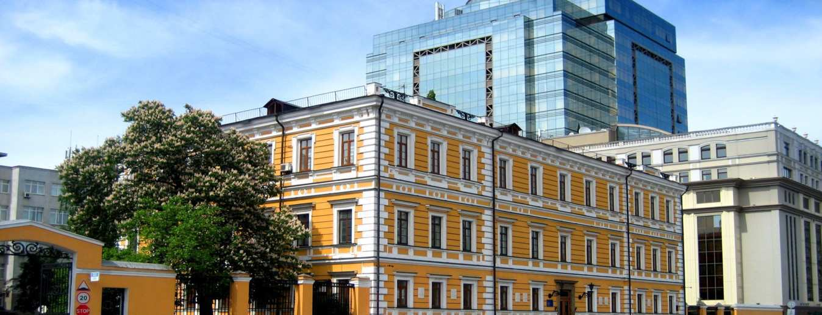
Scientists of Ukraine make a valuable contribution in our science. The Academy of Science of Ukraine includes many outstanding scientists and research workers famous for their important discoveries and inventions.

Slide 3
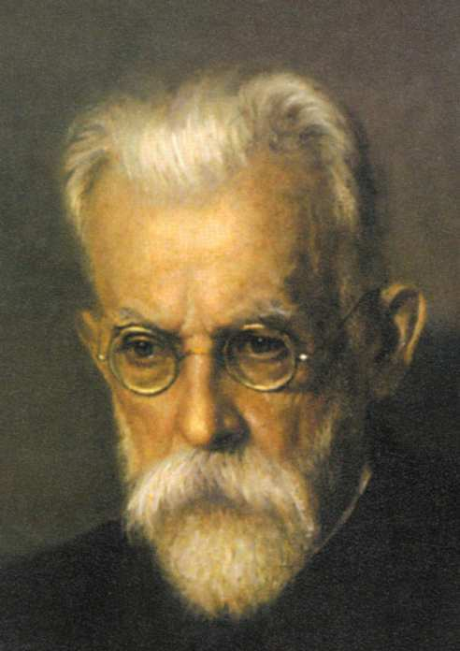
There are a lot of outstanding people famous for their contribution into development of science in Ukraine. Volodymyr Vernadsky, for instance, was the first President of Ukrainian Academy of Sciences. He was the first in our country to introduce the spectral method for the solution of geochemical problems. Vernadsky was the founder of the modern doctrine on the biosphere.

Slide 4
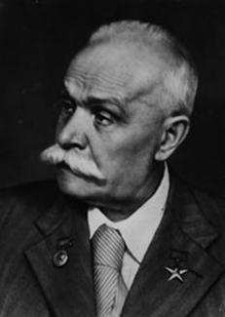
Yevhen Paton is another great scientist whose name is known all over the world. He was the first to apply electric welding in bridge construction. In 193 Paton organized the Research Institute of Electro-welding at the Academy of Sciences.

Slide 5
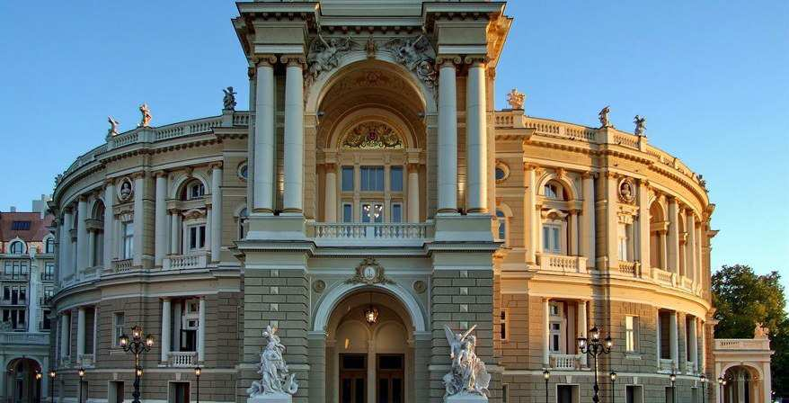
Ukraine has its own original culture and arts. There are many professional theatres and Philharmonic societies in Ukraine. Hundreds of thousands of children are engaged in some or other amateur creative and performing activities.

Slide 6
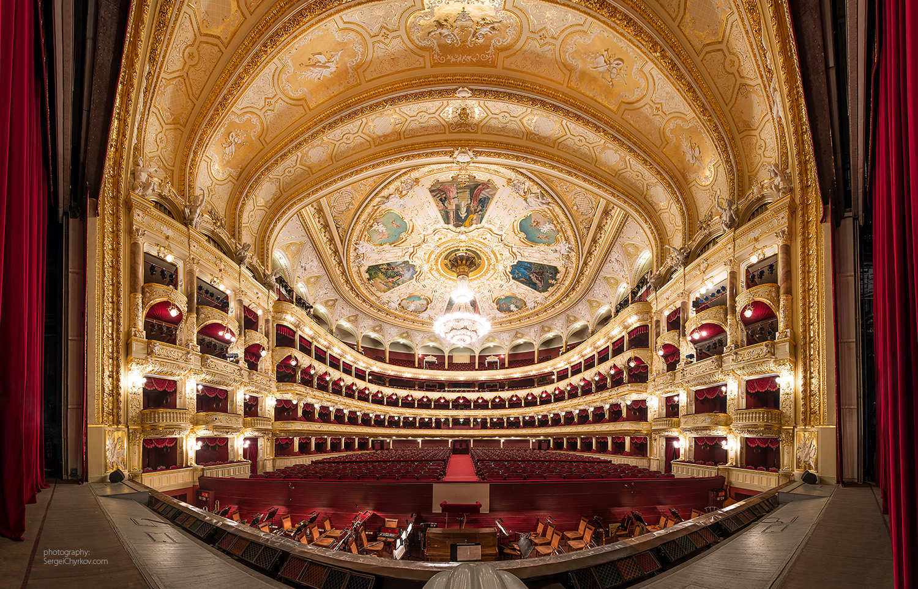

Slide 7
Literature and arts are developing very successfully. Ukrainian books are translated into many languages. The process of reviving Ukrainian culture is also making itself felt in the theatrical art. Practically every drama company stages plays by Ukrainian authors, while of course paying attention to foreign national classics like Shakespeare, Pushkin, Bernard jShow, Ibsen, Servantes.

