Slide 1
Study in Australia

Slide 2
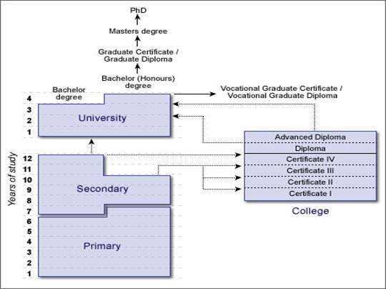
The education system
The education system in Australia provides top notch opportunities for International students seeking world-class academic and individual experience. It provides qualitative education which is highly regarded and widely recognized allover. Australian offers diverse courses, which covers 12 years of primary and secondary education. There is a vast range of study courses available in Australian education, which includes traditional academic programs in addition to the further practical and vocational courses.

Slide 3
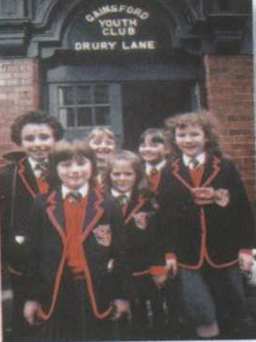
Primary School Primary education of Australia is seven years of preliminary courses, where children commence their education at the age of 5 years (Year-1) and will be completing at the age of 12 (Year-7). This level of education provides general education for the students and gets them ready for a role in society and for the next level of education.
Secondary School Students move to secondary school (Year-8) at the age of 12 and it is mandatory to complete their two years of ‘junior high school’ till the Year-10, after which they have the option to discontinue their education or can pursue their further course of study. Students have to accomplish another 2 years of ‘high school diploma’ (Year-12). Students leaving their school after ‘junior high school’ can also go for vocational education course or for apprenticeship training to enter the work force.
Tertiary School
After completing final year (Year-12) of secondary school, students head for their higher (Tertiary) education that awards degree for Bachelors, Masters and Doctoral studies. Mostly students from overseas come for education at this level. Tertiary education in Australia is within the purview of the Australian Qualification Framework (AQF), which aspires to integrate both vocational and higher education into a solitary classification of tertiary education.

Slide 4
M A R K S
E N G L I S H |  | R U S S I A N
А*(star) | Excellent | -
A | Very good | 5
B | Good | 4
C | Satisfactory | 3
D | Poor | 2
E | Very poor | 1
F | Awful | -

Slide 5
The below diagram shows the different study options that students have after completing different levels of education
Year 10 | Year 11 and then year 12 A vocational program (certificate 1 to certificate 3 depending upon the ability of the student .the course may be held in a school, at a TAFE college or at private college
Year 11 | A one year foundation course to prepare for university entry A certificate 4 programme
Year 12 | A foundation programme; A certificate 4 programme; University undergraduate programme; vocational diploma
Diploma | A university undergraduate programme in year 2 , this again depends on the recognition that the university provides to the diploma
Advanced Diploma | A university undergraduate programme in year 3 , this again depends on the recognition that the university provides to the diploma
Bachelor degree (Under Graduate) | A one-year “Honours” degree (for students who have the ability) A postgraduate qualification
Masters degree (Post Graduate) | PhD

Slide 6
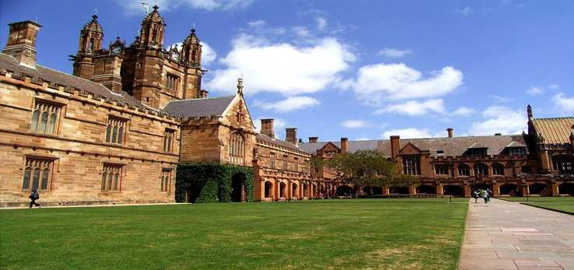
The university

