Slide 1
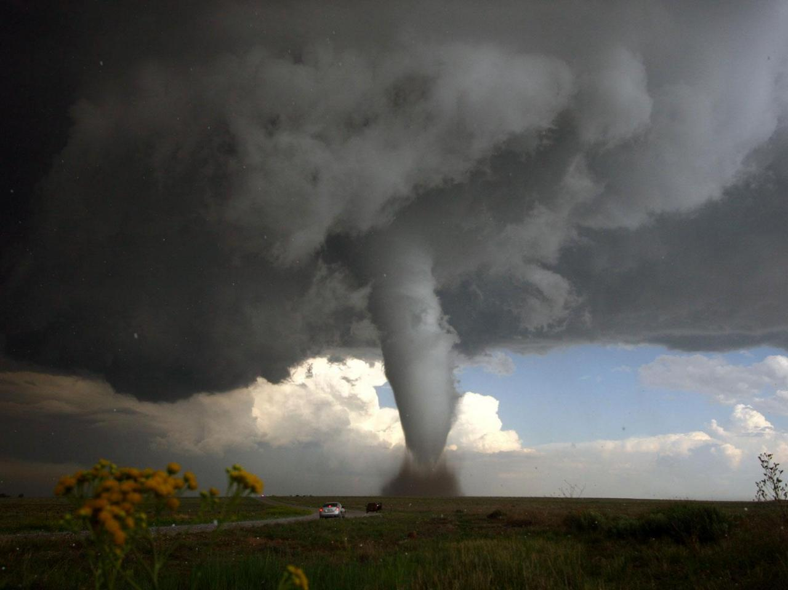
tornado
This presen- tation is dedicated to the spon-taneous evil TORNADO

Slide 2
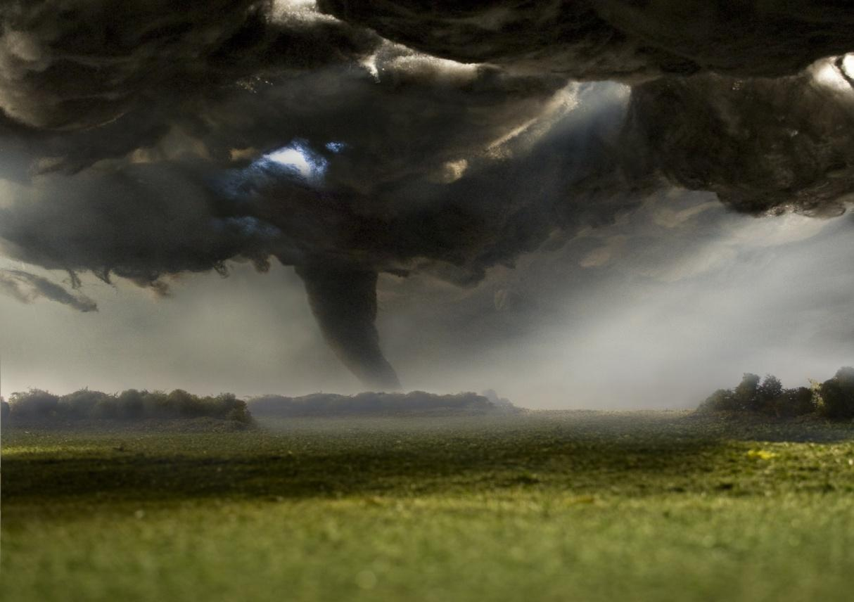
What is a tornado?
Tornado - is atmospheric vortex that occurs in thunderclouds and extends downwards, often to the surface of the Earth in the form of a dark cloud sleeve or a trunk diameter of hundreds of meters.

Slide 3
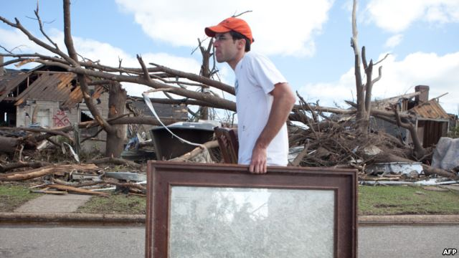
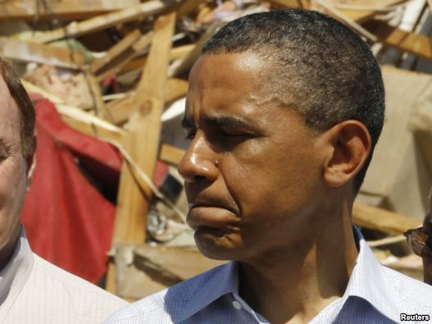
Newly Tornado
President Barack Obama, visited the city of Tuscaloosa in Alabama - this state has undergone a major hit tornado.
He promised as quickly provide federal assistance to victims.
In the city of Tuscaloosa, state Alabama, after tornadoes
Alabama, Mississippi and Georgia declared areas of maximum destruction. Objectives street just razed to the ground, even stone buildings stood not, because the wind speed reached 330 kilometers per hour.

Slide 4
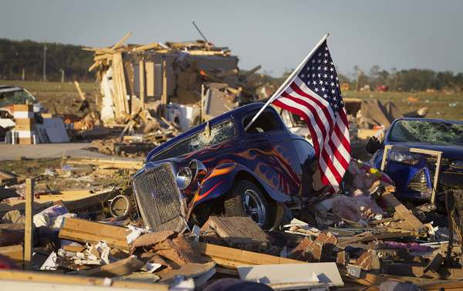
facts about tornadoes
1. Tornado invisible
It's true - he tornadoes, invisible, like the wind, literally.
What you see is a tornado moisture in the air, and lots
of dust and debris that tornado picked up along the way.
2. Each with its own smell
Hunters say that every tornado funnel has its own unique
personality type, with a distinct smell and color.
3. They can appear anywhere
While some places are more prone than others, tornadoes
can appear and appear everywhere on Earth. Tornadoes can occur over any type of terrain, including water, mountains and dense urban areas.
4. Hide in a ditch not help
One of the tips in the event of a tornado - hide in a ditch, supposedly because tornadoes are directly above you at ground level. People are not looking for shelter from a tornado in a ditch. It will not work outside of not taking you. Many people died as a result of bad advice.

Slide 5
Statistics tornadoes in the USA
Each year in the United States noted in an average of 1,000 tornadoes in which, on average, about 80 people are killed and 1,500 injured. Tornadoes in this country can occur anywhere and at any time of the year. In the southern states of the peak of the destructive phenomena to the period from March to May. In the northern states, peaking during the summer months only.
Statistics states where most tornadoes during the year
1. Texas (155)
2. Kansas (96)
3. Florida (66)
4. Oklahoma (62)
5. Nebraska (57)
6. Illinois (54)
7. Colorado (53)
8. Iowa (51)
9. Minnesota (45)
10. Missouri (45)

