Slide 1
Dubai - the largest city of the United Arab Emirates and the administrative center of Dubai

Slide 2
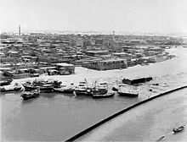
History of Dubai:
Seven thousand years ago Dubai area was covered mangrove swamp, the remains of which were discovered during the construction of sewer lines. About five and a half thousand years ago as a result of changes in the coastline area was covered with sand. The first settlement in the history of Dubai dates back to the third millennium , when the area was inhabited by nomadic tribes.

Slide 3
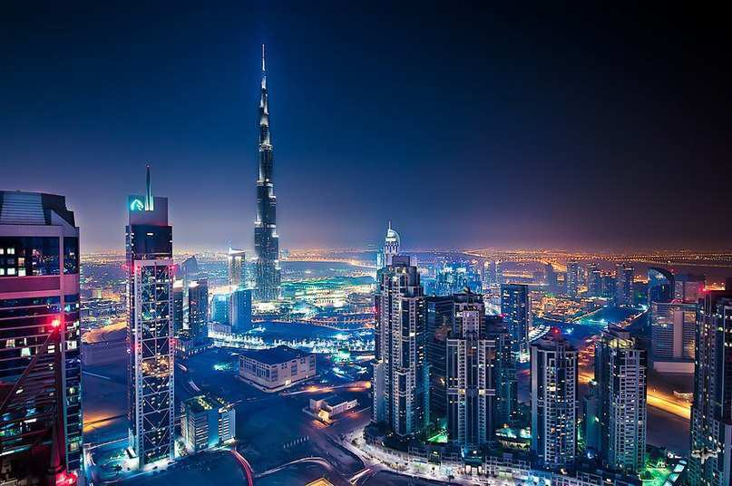
Description of the city:
Dubai - is a vivid kaleidoscope of contrasts, where neighbors modern city and boundless desert, East and West, old and new. Dubai streets are clean and safe, offers a warm and friendly welcome. Holidaymakers tired of bad weather and bustle, or active tourists, eager unusual experience - one will find in Dubai what it wants.

Slide 4
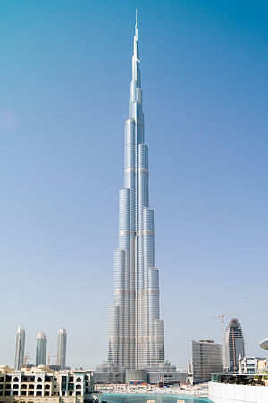
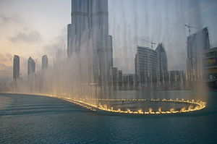
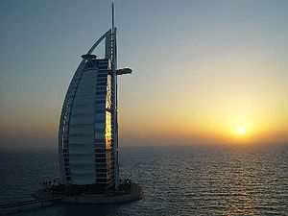
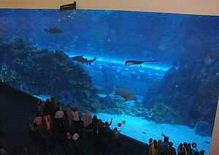
Attractions:
1)Burj Khalifa - the skyscraper that resembles a stalagmite
2) Dubai Fountain - a musical fountain, an artificial lake located in an area of ​​over 12 hectares near the Burj Khalifa in downtown Dubai
4) Burj Al Arab - luxury hotel in Dubai, the largest city of the United Arab Emirates. The building stands in the sea at a distance of 280 meters from the shore on an artificial island connected to the mainland by means of a bridge.
3) Aquarium mall "Dubai" - one of the largest aquariums of the world, located in the largest shopping mall in the Middle East - "Dubai".

Slide 5
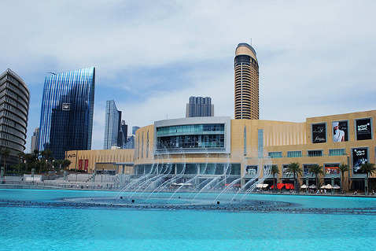
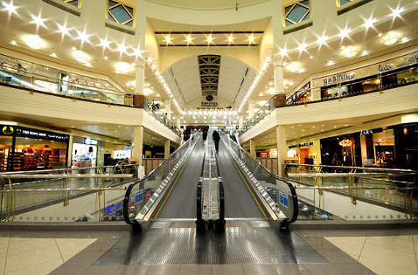
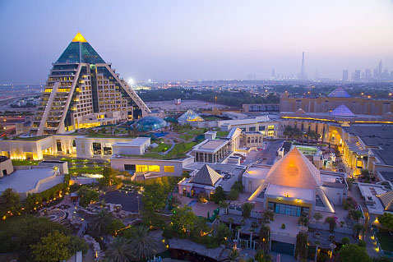
Shopping at Dubai: Major shopping areas in the capital of the Middle East trade!
The Dubai Mall
Deira City Center
Wafi shopping mall
To be here fifty football fields, built dozens of unique structures. Among them, an Olympic-size ice rink, artificial waterfall, and Dubai Aquarium. Gallery with 70 boutiques, haute couture luxury brands.
Inside a giant pavilion fit more than two hundred shops, twelve cinemas, a bowling alley and children's complex Magic Planet.
Wafi is one of the most expensive and stylish in the city. More than 250 elite shops include the largest representation in the region jewelry firms.

Slide 6
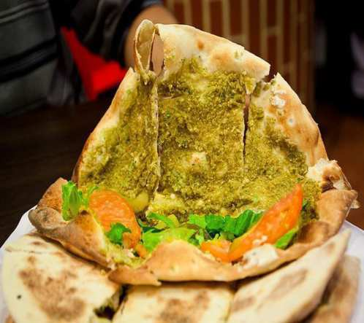
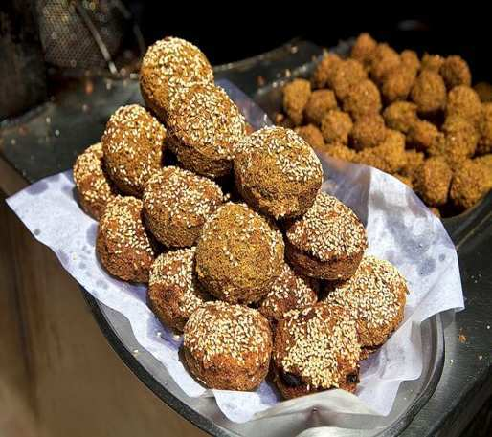
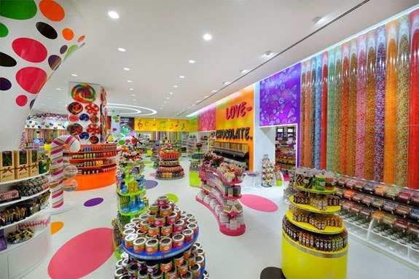
Dubai food:
One of the tastiest dishes with bread called Manakish.
This Arabic dish called "Falafel"
It is the largest shop with sweets in Dubai, which is famous far beyond the borders of the country.
But unfortunately, there is no national sweets presented. Basically candy from around the world, and from the local - Dubai's only fresh cakes.

Slide 7
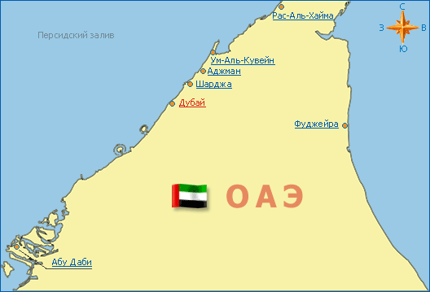
THE END!

