Slide 1
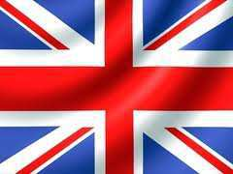
Great Britain. London.

Slide 2
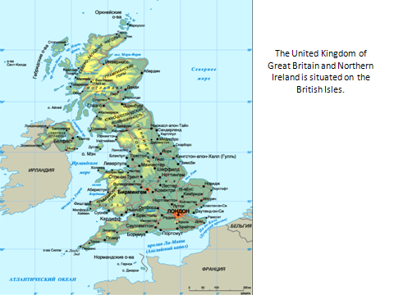

Slide 3
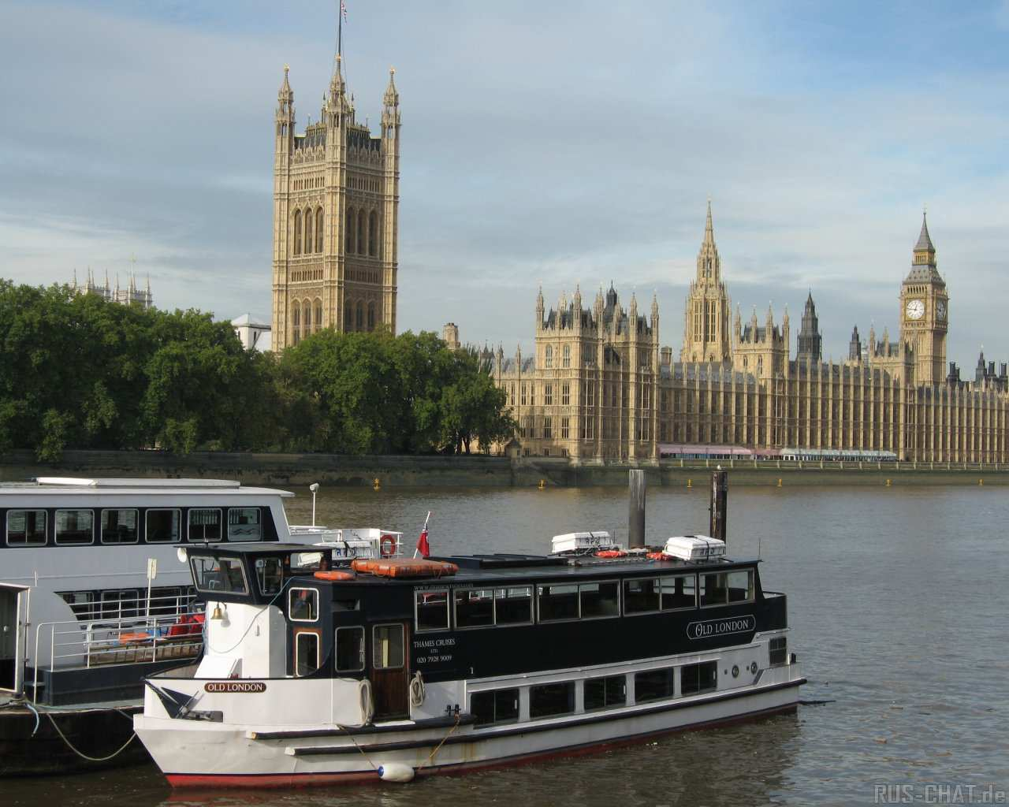
The capital of Great Britain is London. It is situated on the river Thames. The Houses of Parliament is the seat of the British Government.

Slide 4
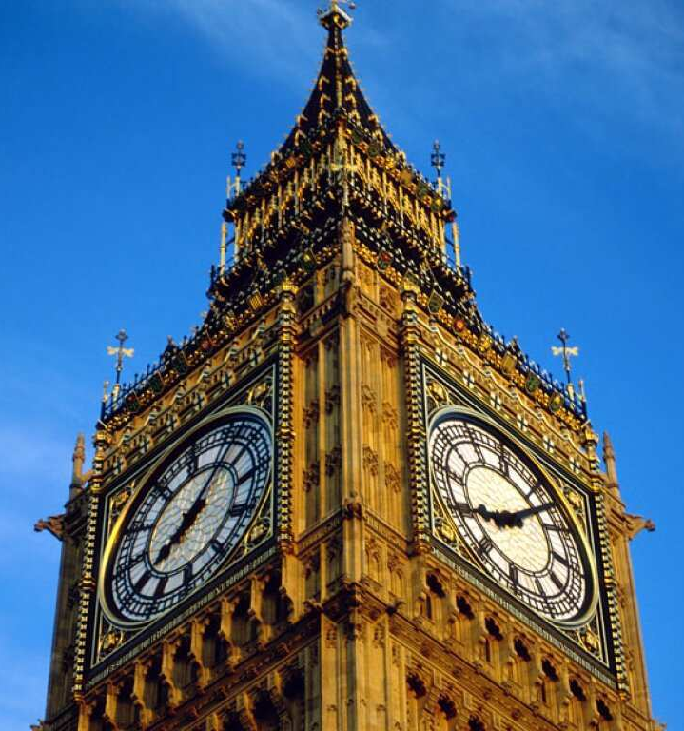
The tallest tower of the Houses of Parliament with the clock on it is Big Ben.

Slide 5
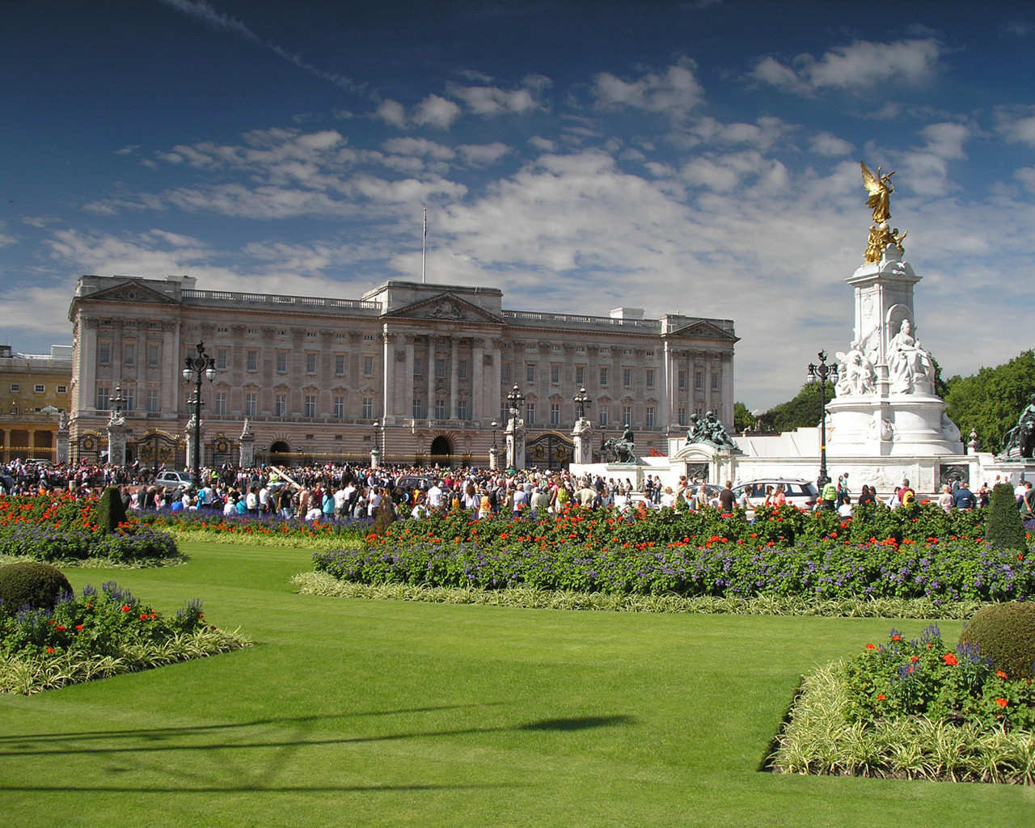
In the centre there is a Buckingham Palace. Queen Elizabeth lives there.

Slide 6
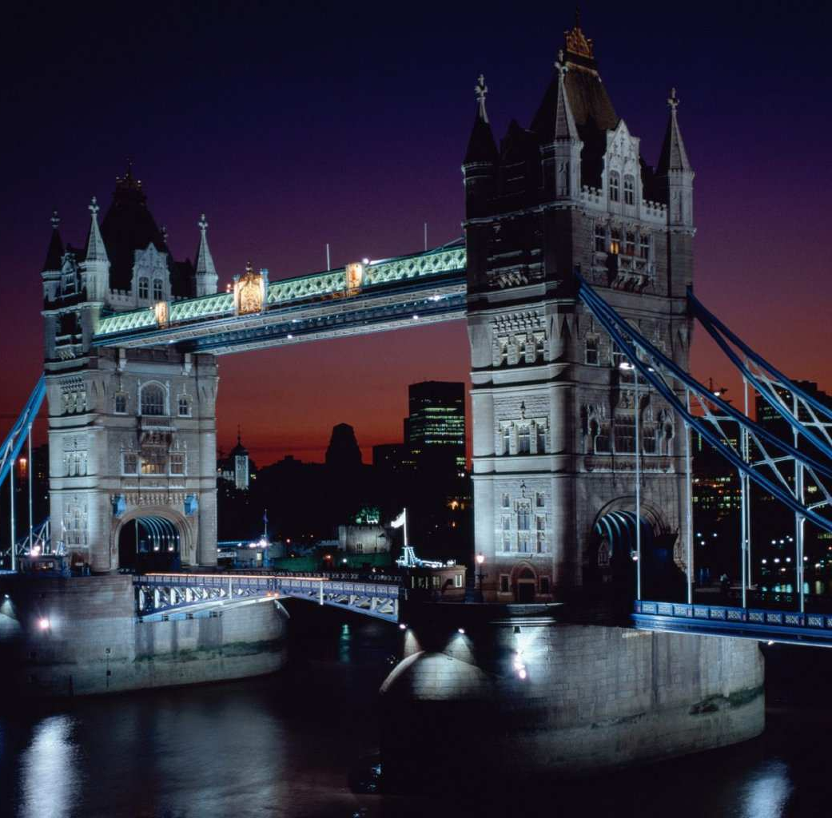
Crossing the river by Tower Bridge…

Slide 7
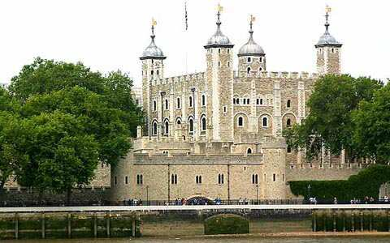
You can see the Tower of London. Many centuries ago it was a fortress, a Royal Palace and then a prison. Now it is a museum.

Slide 8
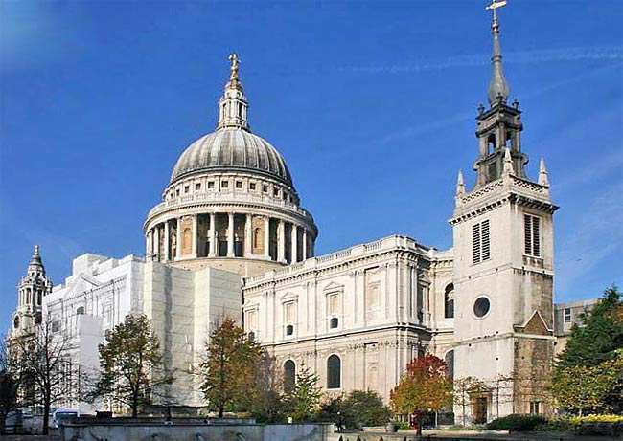
St.Paul’s Cathedral is the biggest English church.

Slide 9
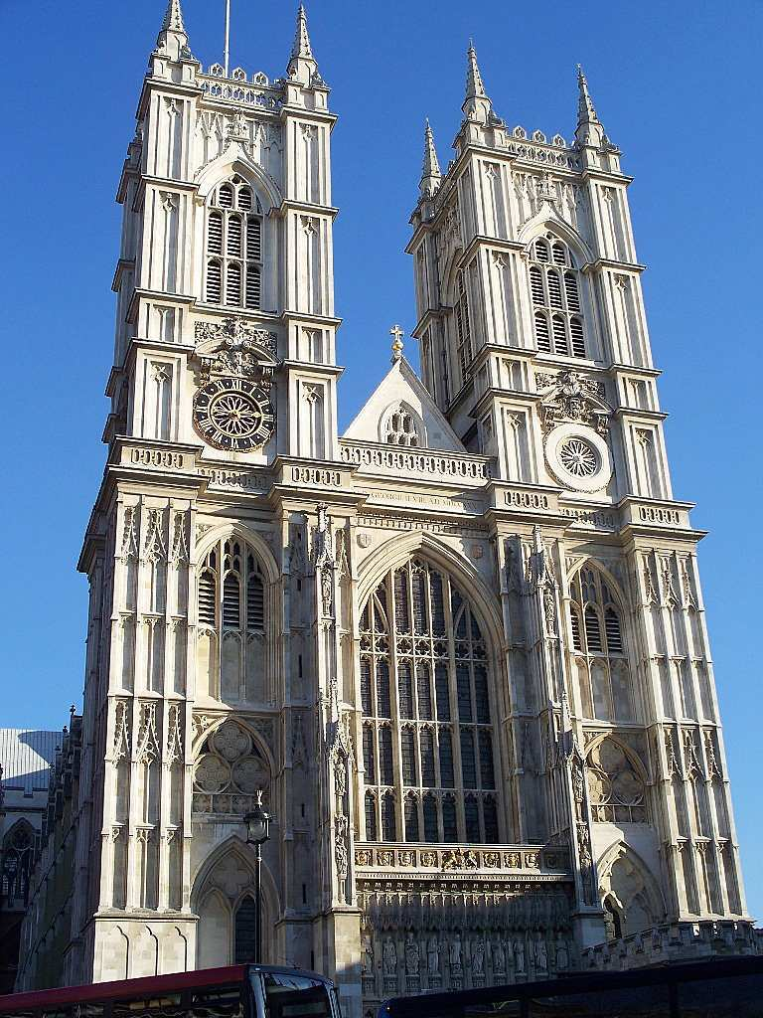
Westminster Abby is one of the oldest building in London. Many kings and queens are buried there.

Slide 10
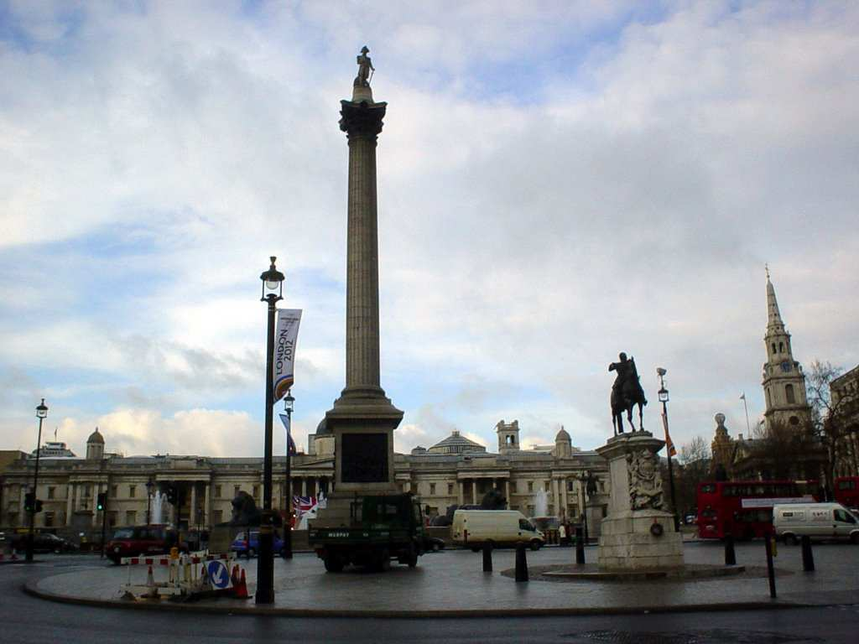
In the centre of Trafalgar Square is the monument to Nelson.

Slide 11
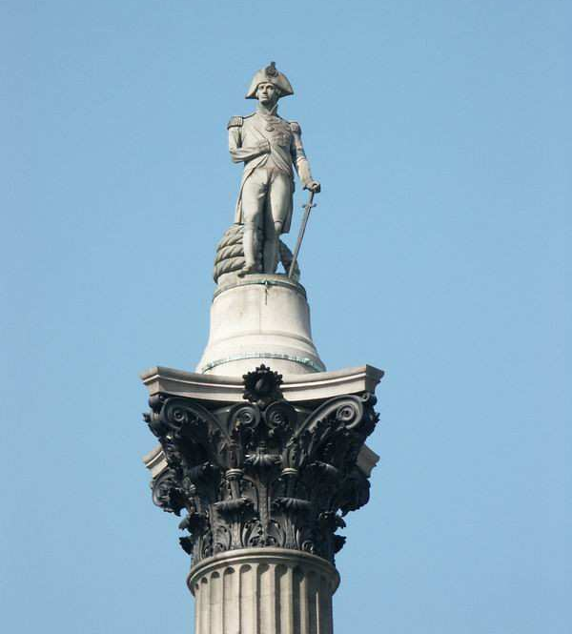
Admiral Nelson is the national hero of Great Britain.

Slide 12
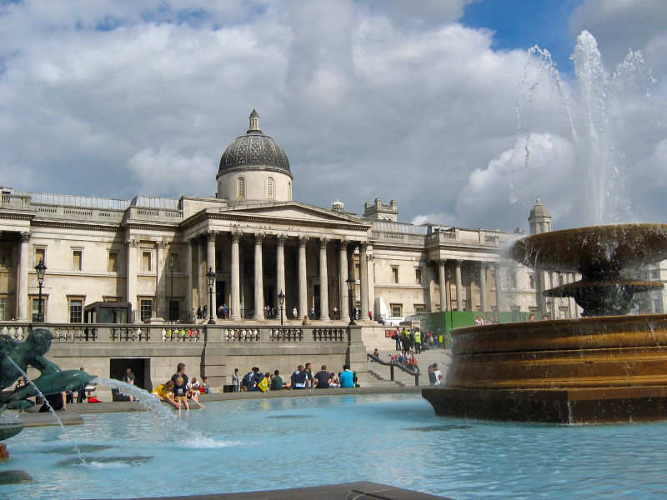
To the right of Trafalgar Square there is the National Gallery which has a fine collection of European paintings.
T

Slide 13
